Slide 1

Mahmut ÇELİK

Slide 2
Design Patterns
In software engineering, a design pattern is a general repeatable solution to a commonly occurring problem in software design.
A design pattern isn't a finished design that can be transformed directly into code. It is a description or template for how to solve a problem that can be used in many different situations

Slide 3



ENCOUNTERED SAME
PROBLEMS
DESIGN
PATTERNS

Slide 4
Advantages of Design Patterns
Reusability: Design patterns are reusable solutions to commonly occurring problems in software development. Once a design pattern is established, it can be used in many different applications, saving developers time and effort.
Scalability: Design patterns help to create software architectures that are scalable and maintainable over time. This is especially important for large and complex software systems that need to evolve over time.
(Evrimli mimari)
Standardization: Design patterns provide a standardized approach to software development, making it easier for developers to communicate and collaborate with each other. This is particularly important when working on projects with multiple developers or teams.
Flexibility: Design patterns are flexible and can be adapted to meet the specific needs of a project or application. Developers can modify existing patterns or create new ones to suit their needs.
Efficiency: Design patterns promote efficient coding practices and help to reduce development time and costs. They provide developers with proven solutions to common problems, allowing them to focus on other aspects of software development.
Quality: Design patterns improve the quality of software by providing a structured and organized approach to development. This results in software that is easier to maintain, debug, and enhance over time.

Slide 5
Creational Design Patterns
Creational design patterns are a category of design patterns that focus on object creation mechanisms, which increase flexibility and reuse of existing code.
They provide various ways to create objects in software systems while decoupling the object creation process from their usage.
In software development, creating objects can be a complex and error-prone process, especially when the objects have complex dependencies or require specific initialization parameters. Creational design patterns help to simplify and standardize the object creation process, making it easier to manage.

Slide 6
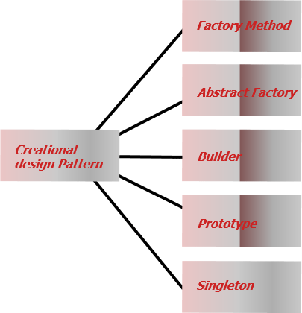

Slide 7
SINGLETON
Problem
Solution (Implementation)
1- Singleton pattern restricts the instantiation of a class and ensures that only one instance of the class exists in the Java Virtual Machine.
2- The singleton class must provide a global access point to get the instance of the class.
1- Make the default constructor private, to prevent other objects from using the new operator with the Singleton class
2- Create a static creation method that acts as a constructor.

Slide 8
Environment Examples That Used Singleton Design Pattern
Spring Framework: In the Spring Framework, the Singleton design pattern is used extensively to manage the lifecycle of objects. By default, all Spring beans are singletons, which means that there is only one instance of the bean in the application context.
Java Database Connectivity (JDBC): In JDBC, the Singleton design pattern can be used to create a single database connection object that is shared by all components in the application. This helps to reduce the overhead of creating and closing database connections.
Thread pool: In applications that use threads to perform tasks, a thread pool can be used to manage the threads. A Singleton design pattern can be used to ensure that there is only one instance of the thread pool, which helps to prevent resource contention and improve performance.
Network connections: In applications that communicate over a network, a Singleton design pattern can be used to manage network connections. By using a Singleton to manage the network connection object, you can ensure that there is only one instance.
Configuration management: In applications that use configuration files to manage settings, the Singleton design pattern can be used to manage the configuration object. By using a Singleton to manage the configuration, you can ensure that there is only one instance of the configuration, and that it is shared by all components in the application.
System resources: In applications that use system resources, such as memory or file handles, a Singleton design pattern can be used to manage the resources. By using a Singleton to manage the resources, you can ensure that there is only one instance of the resource manager, which helps to prevent resource contention and improve performance.

Slide 9
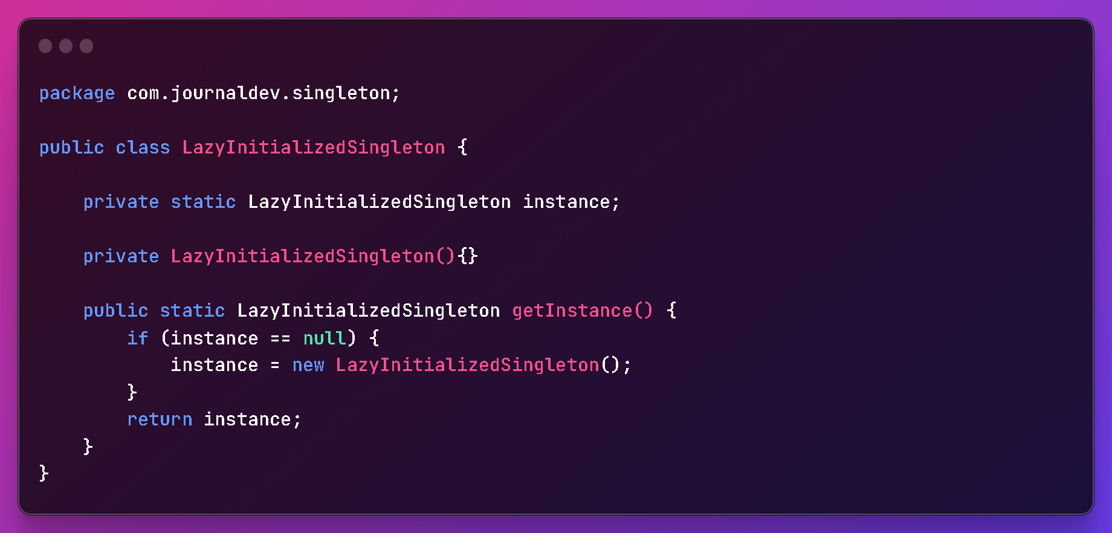
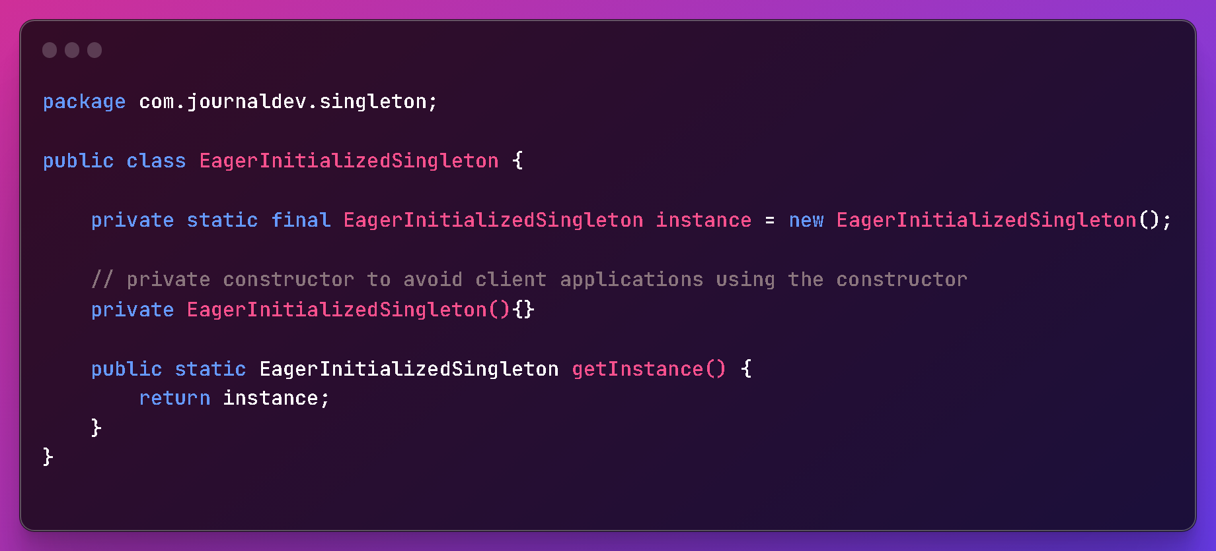
Lazy
Initialization
Eager Initialization

Slide 10
PROTOTYPE
The Prototype design pattern is used to solve problems related to creating new objects by copying or cloning existing ones, instead of creating them from scratch. This can be useful in situations where creating an object is a time-consuming or resource-intensive process, or when creating a new object requires a lot of initialization that can be copied from an existing object.
Some common problems that can be solved by the Prototype pattern include:
Creating new objects without incurring the overhead of object creation and initialization
Creating a large number of similar objects efficiently
Customizing existing objects by cloning and modifying their properties
Creating complex objects with many interconnected parts, where each part can be cloned independently

Slide 11

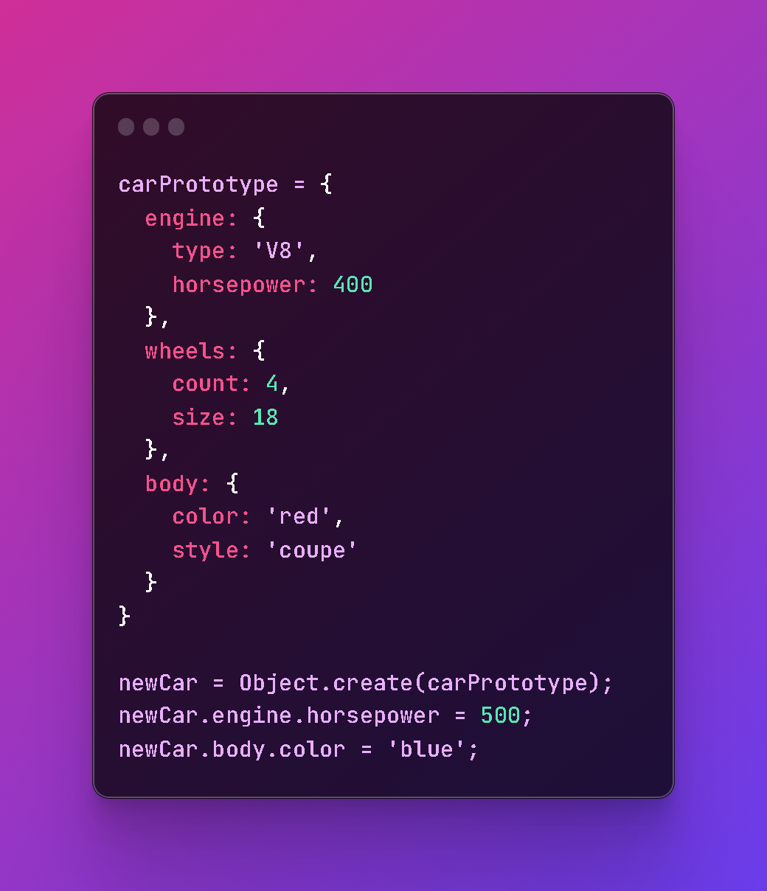


Slide 12
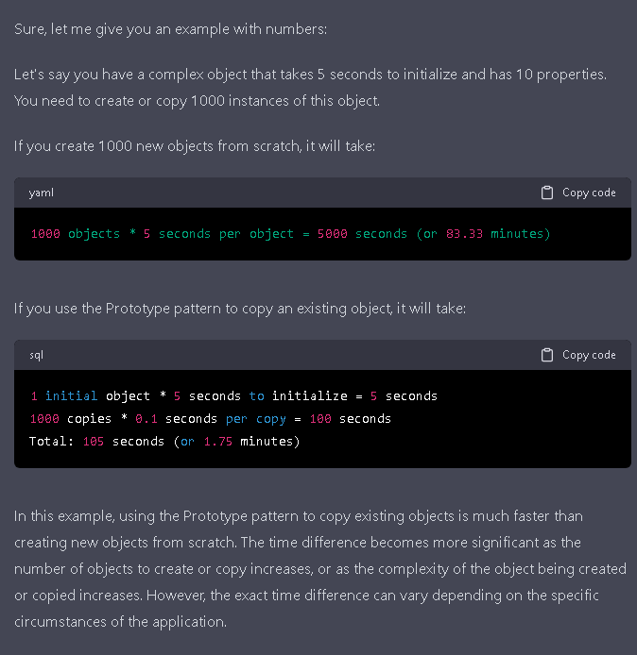
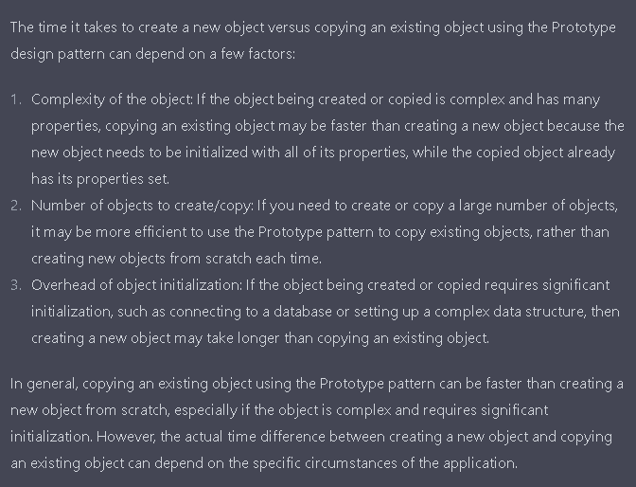

Slide 13
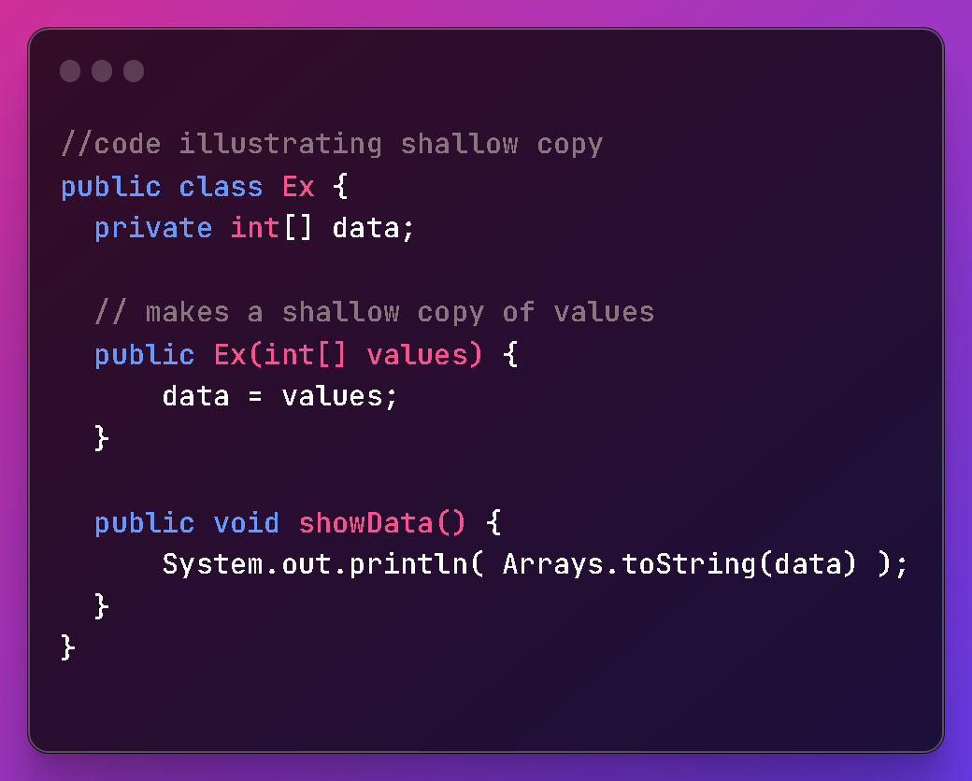
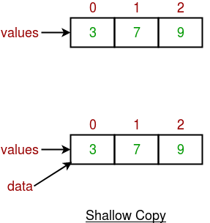
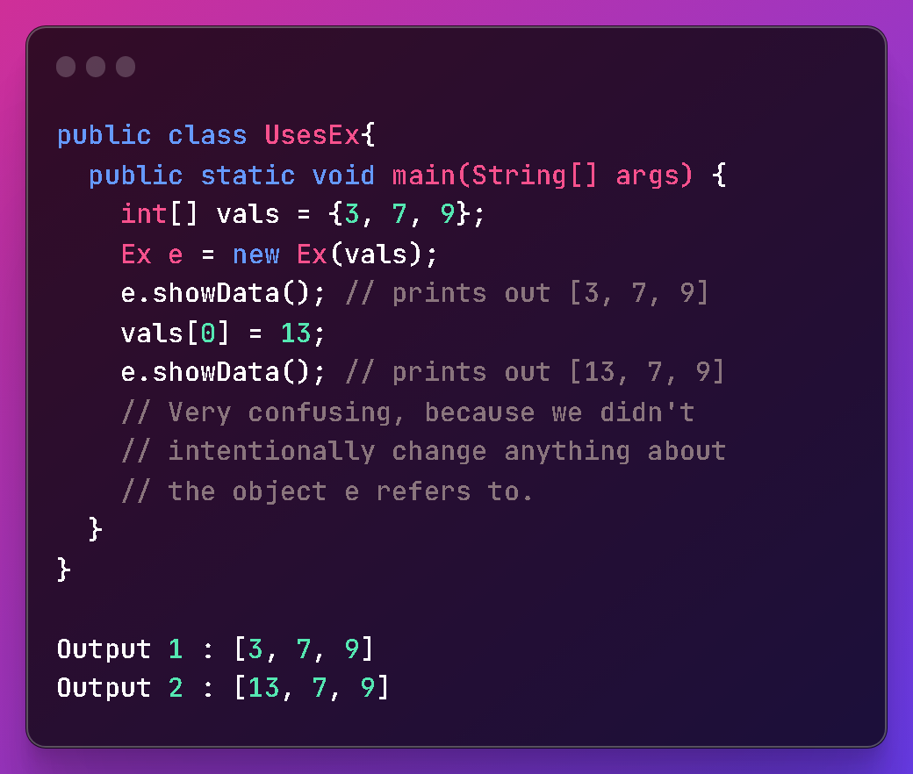
Shallow Copy
Whenever we use default implementation of clone method we get shallow copy of object means it creates new instance and copies all the field of object to that new instance and returns it as object type, we need to explicitly cast it back to our original object. This is shallow copy of the object.
clone() method of the object class support shallow copy of the object
That’s why the name shallow copy or shallow cloning in Java. If only primitive(int,char,long,boolean) type fields or Immutable(String) objects are there then there is no difference between shallow and deep copy in Java.

Slide 14
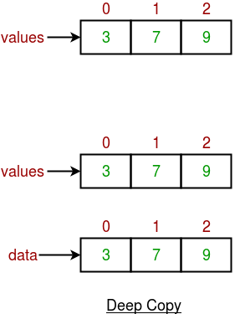
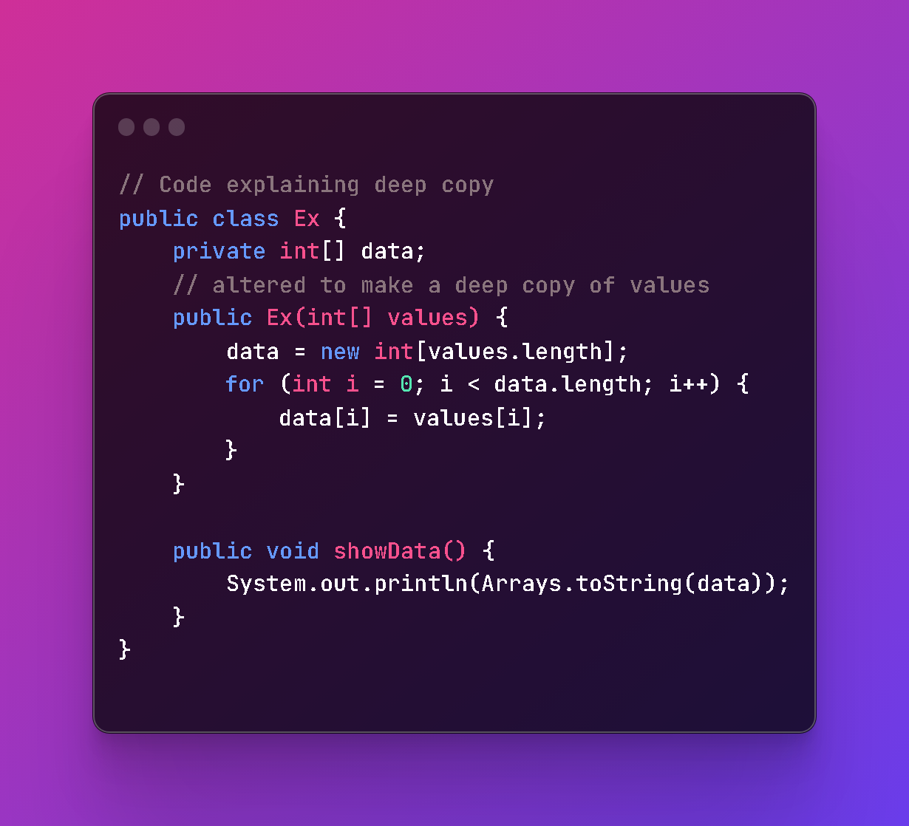
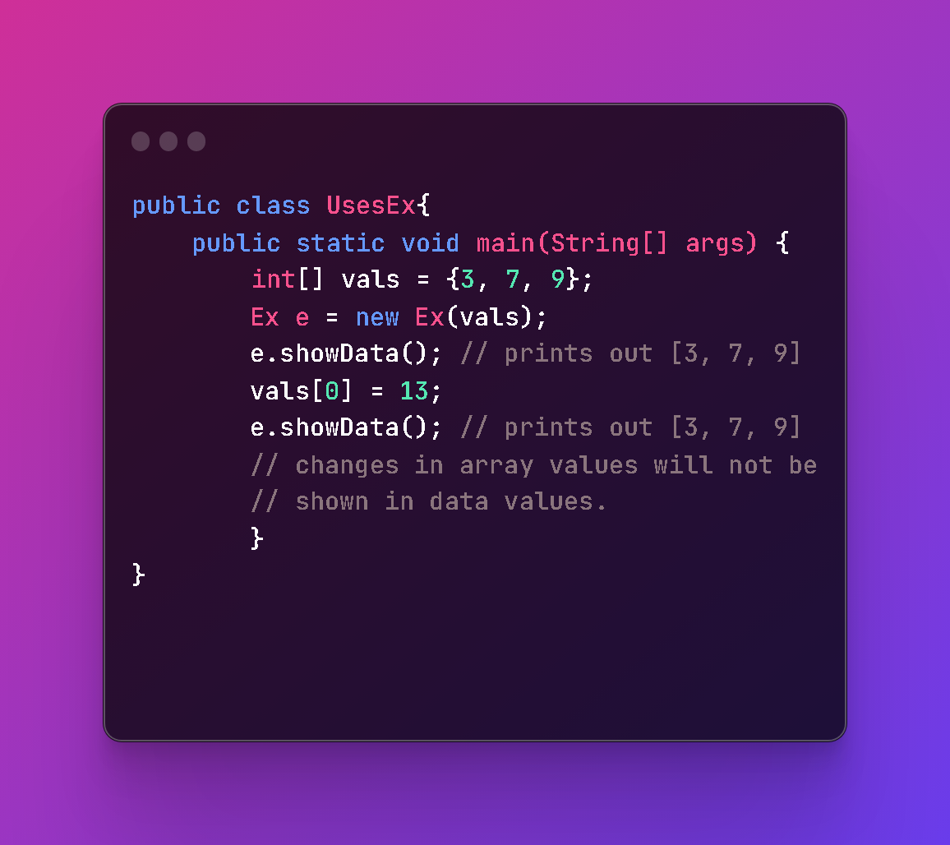
Deep Copy
Whenever we need own copy not to use default implementation we call it as deep copy, whenever we need deep copy of the object we need to implement according to our need.
A deep copy means actually creating a new array and copying over the values.

Slide 15

Lazy Copy: A lazy copy can be defined as a combination of both shallow copy and deep copy. The mechanism follows a simple approach – at the initial state, shallow copy approach is used. A counter is also used to keep a track on how many objects share the data. When the program wants to modify the original object, it checks whether the object is shared or not. If the object is shared, then the deep copy mechanism is initiated.
There is no hard and fast rule defined for selecting between shallow copy and deep copy but normally we should keep in mind that if an object has only primitive fields, then obviously we should go for shallow copy, but if the object has references to other objects, then based on the requirement, shallow copy or deep copy should be done. If the references are not updated then there is no point to initiate a deep copy.

Slide 16
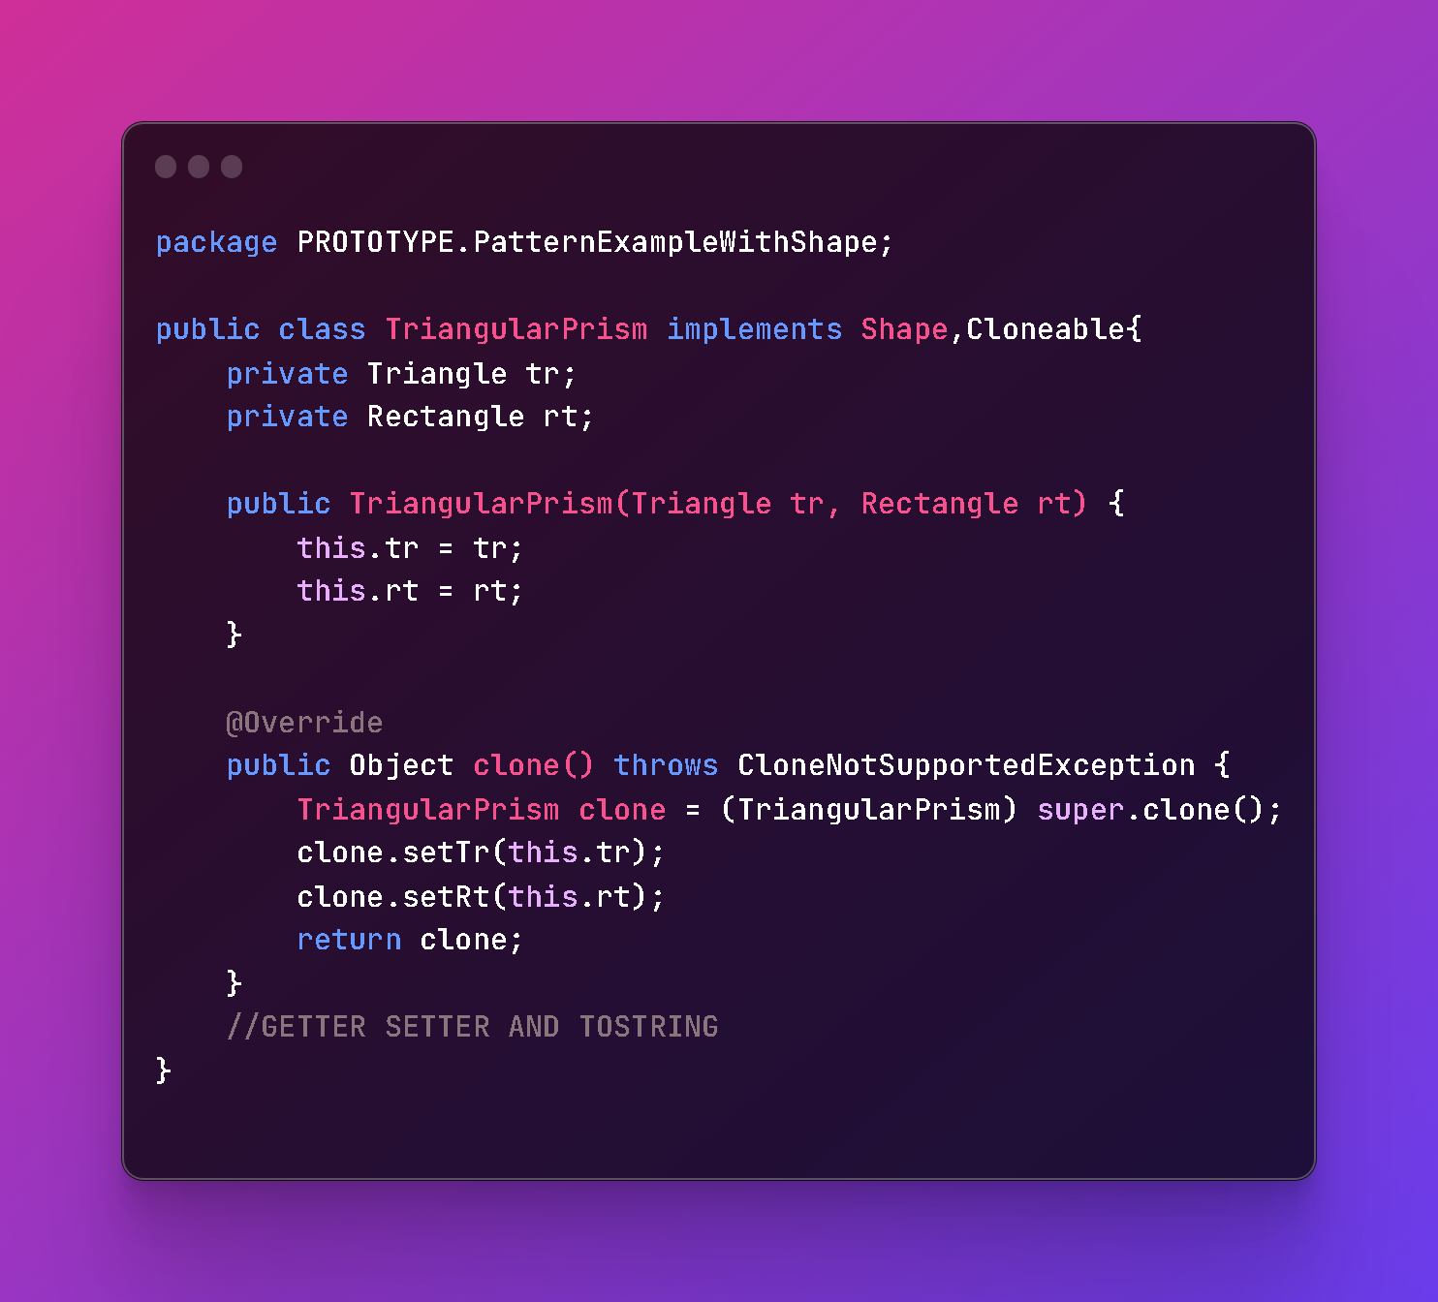
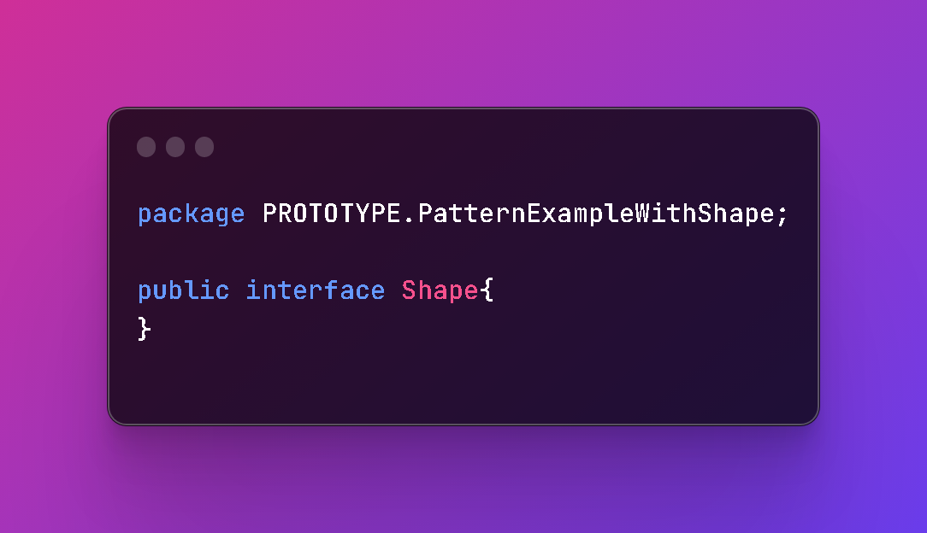
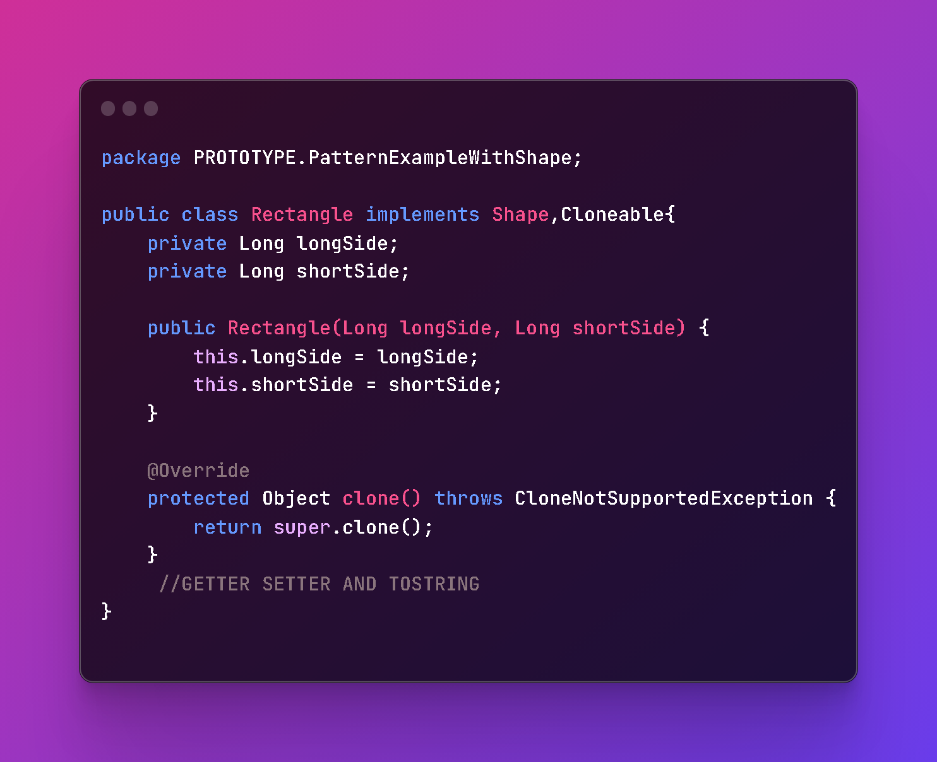
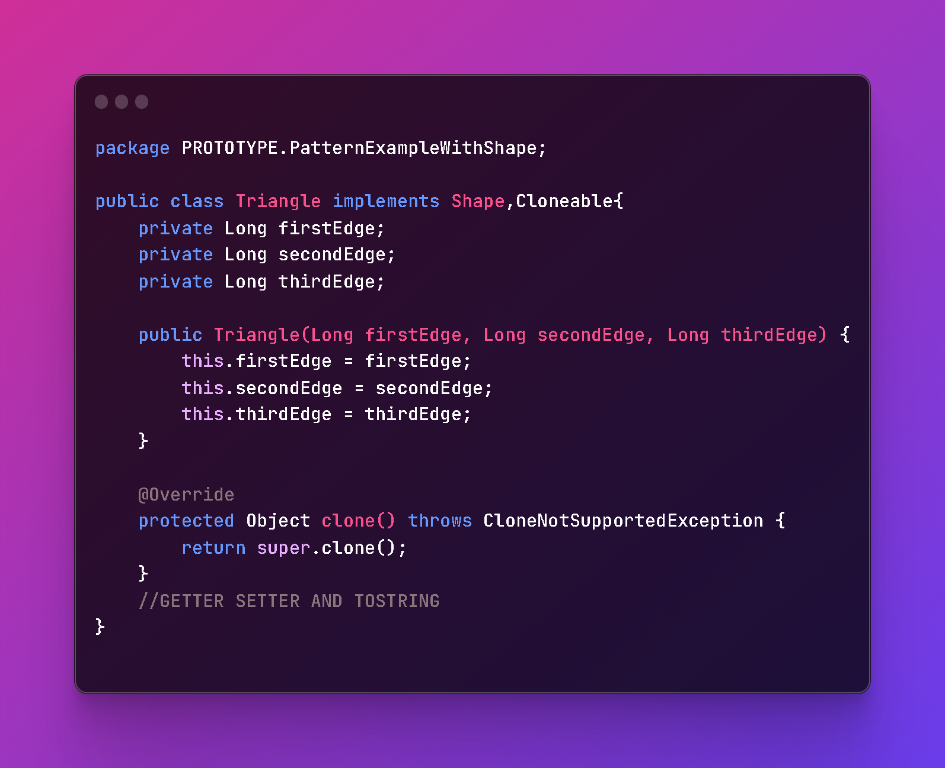

Slide 17
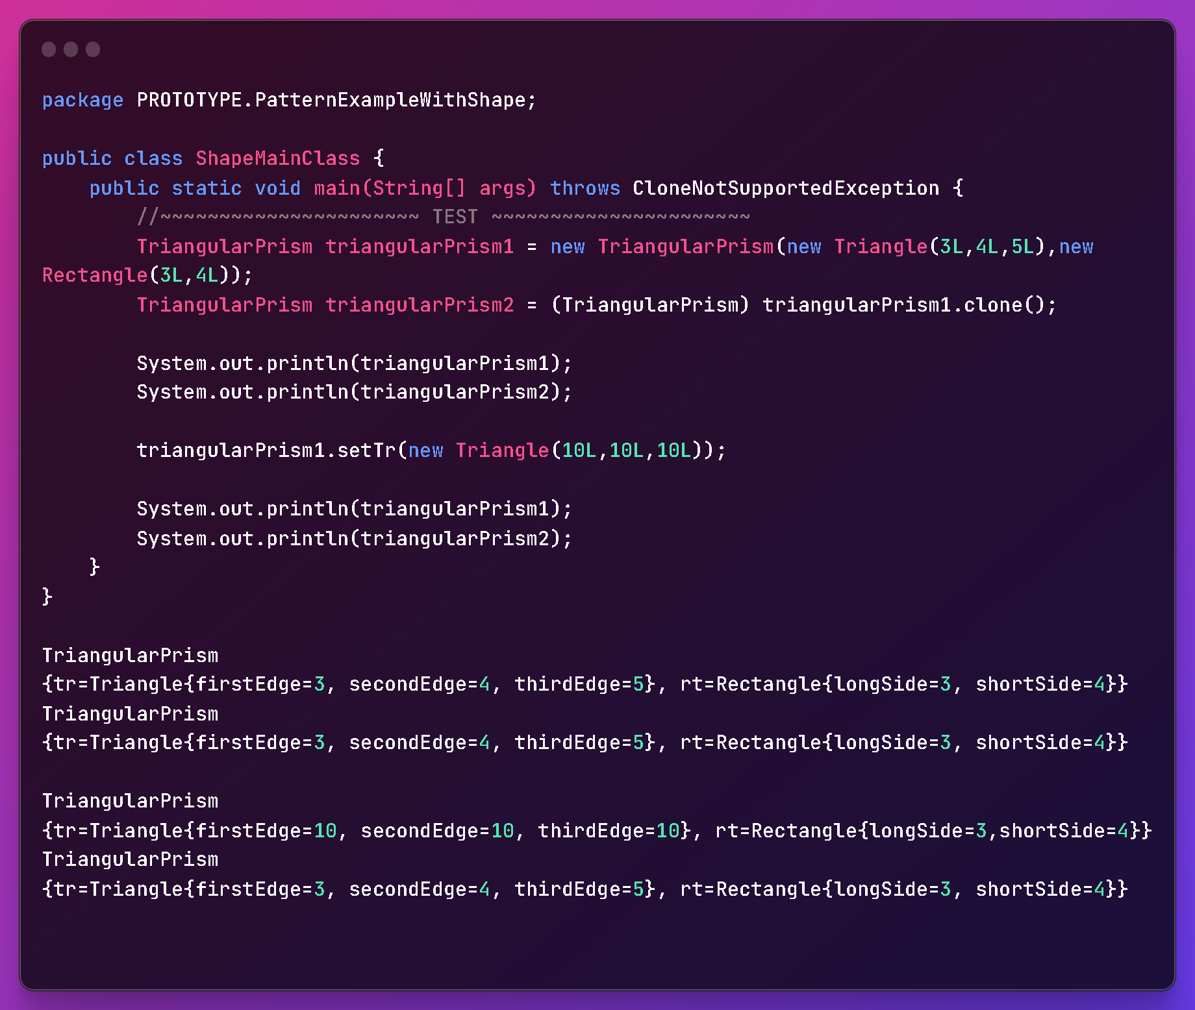

Slide 18
FACTORY
How Does it Work?
The factory design pattern is a creational design pattern that provides an interface for creating objects in a superclass, but allows subclasses to alter the type of objects that will be created.
In other words, the factory design pattern provides a way to encapsulate object creation in a superclass, so that the responsibility of creating objects is delegated to subclasses. This allows the code to be more flexible and extensible, as new types of objects can be added without changing the superclass.
The client code requests an object to be created, but instead of calling a constructor directly, it calls a factory method on a factory object.
The factory object creates the object and returns it to the client code.
The client code uses the object returned by the factory to do its work.

Slide 19
Some common problems that can be solved by the Factory pattern include:
Complex object creation logic: If the creation of an object involves complex logic, such as validation, configuration, or dependency injection, it can be difficult to manage that logic within the client code. The factory pattern allows you to encapsulate that logic within a factory class, so that the client only needs to provide the necessary inputs and can rely on the factory to create the object correctly.
1
Multiple ways to create an object: If there are multiple ways to create an object (e.g. with different parameters or configurations), it can be difficult to manage all of those possibilities within the client code. The factory pattern allows you to provide different factory methods or subclasses to handle different scenarios, so that the client can simply call the appropriate method or subclass.
2
Changing object creation logic: If the way that objects are created needs to change (e.g. due to a new requirement or dependency), it can be difficult to update all of the client code that creates those objects. The factory pattern allows you to centralize the creation logic within a factory class, so that changes can be made in a single place.
3
Dependency inversion: If the client code needs to depend on an interface or abstract class rather than a concrete implementation, the factory pattern can help to facilitate that dependency inversion. The factory class can be responsible for instantiating the concrete implementation and returning it to the client.
4
The factory pattern can help to make your code more modular, flexible, and maintainable by separating object creation from object usage and providing a centralized place to manage object creation logic.
5

Slide 20
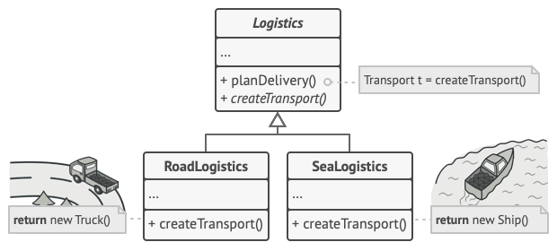
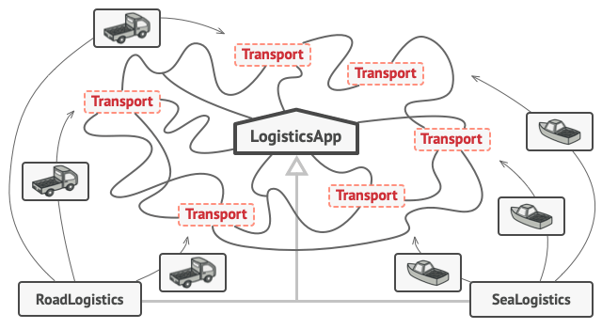
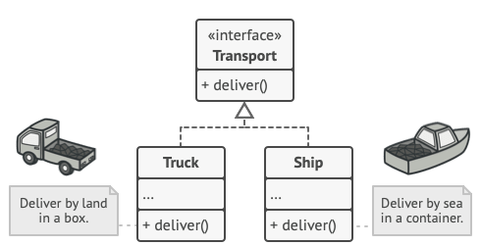

Slide 21
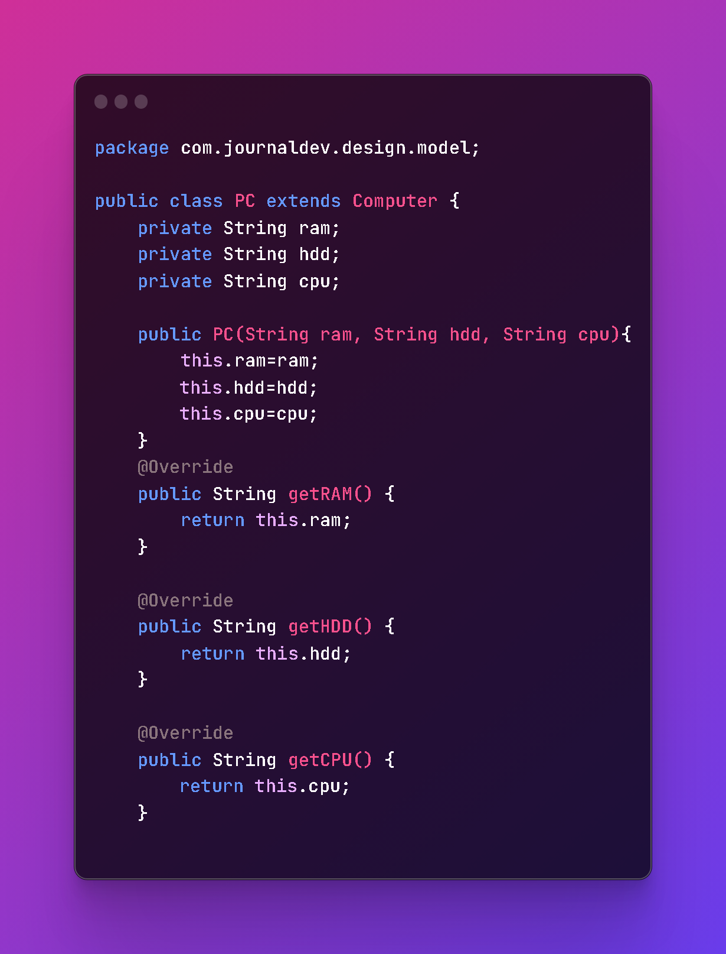
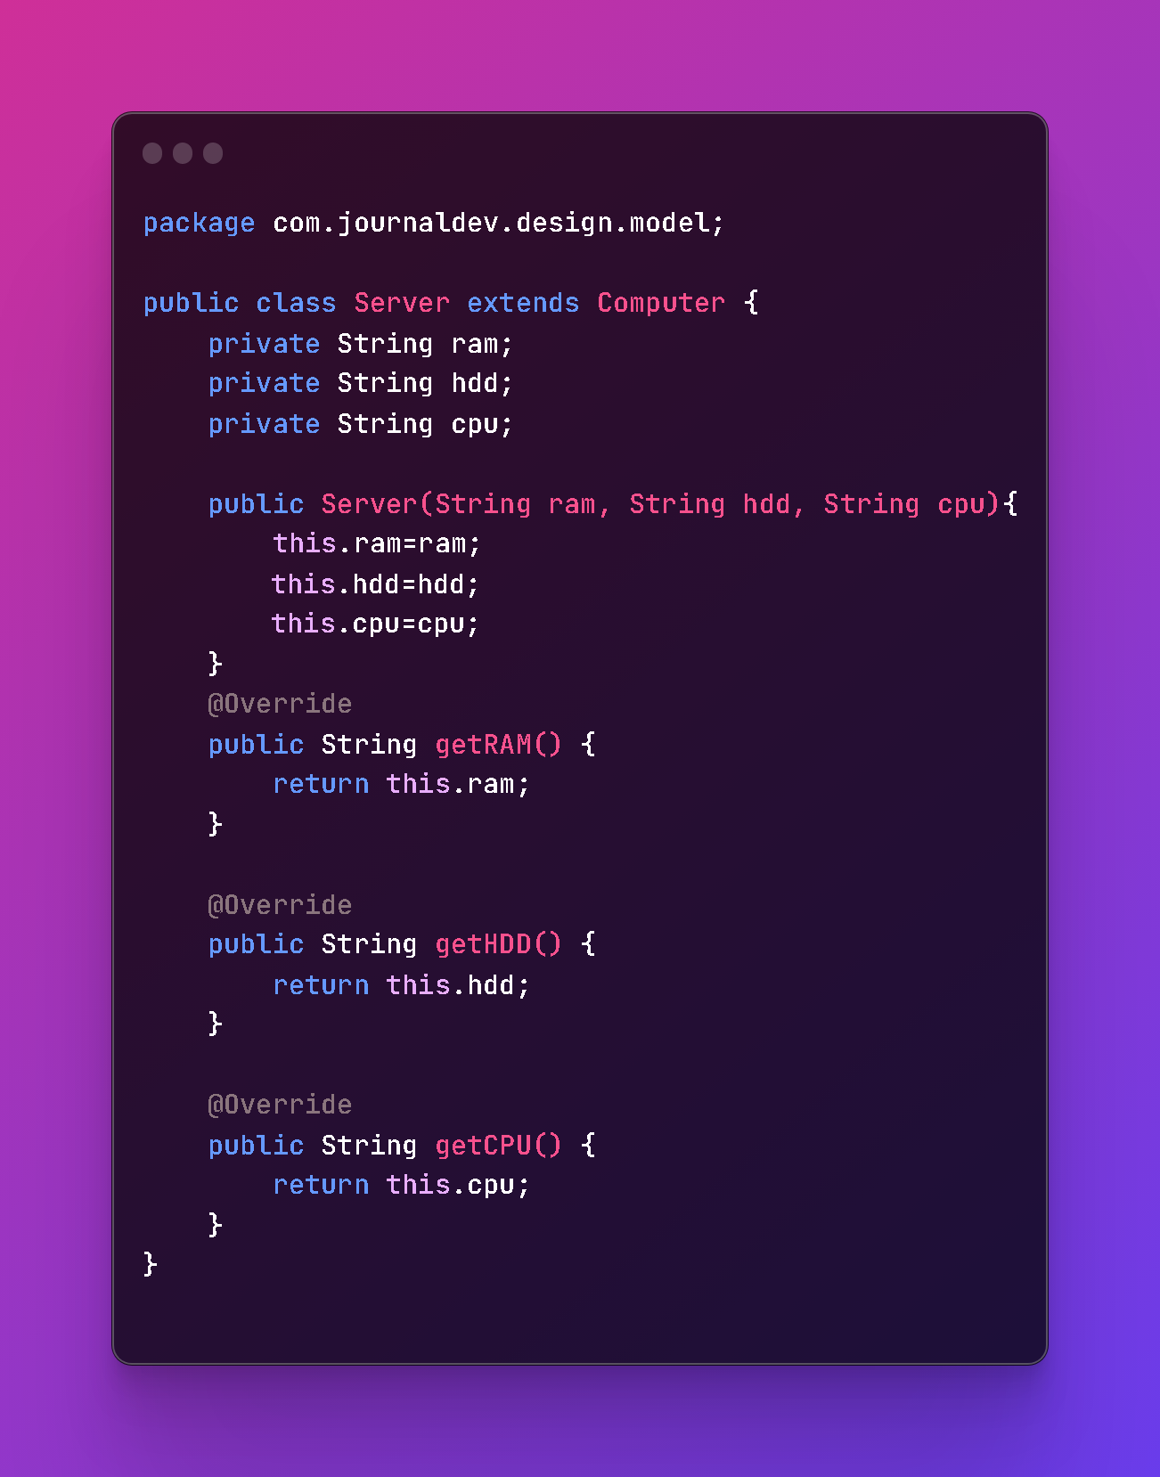
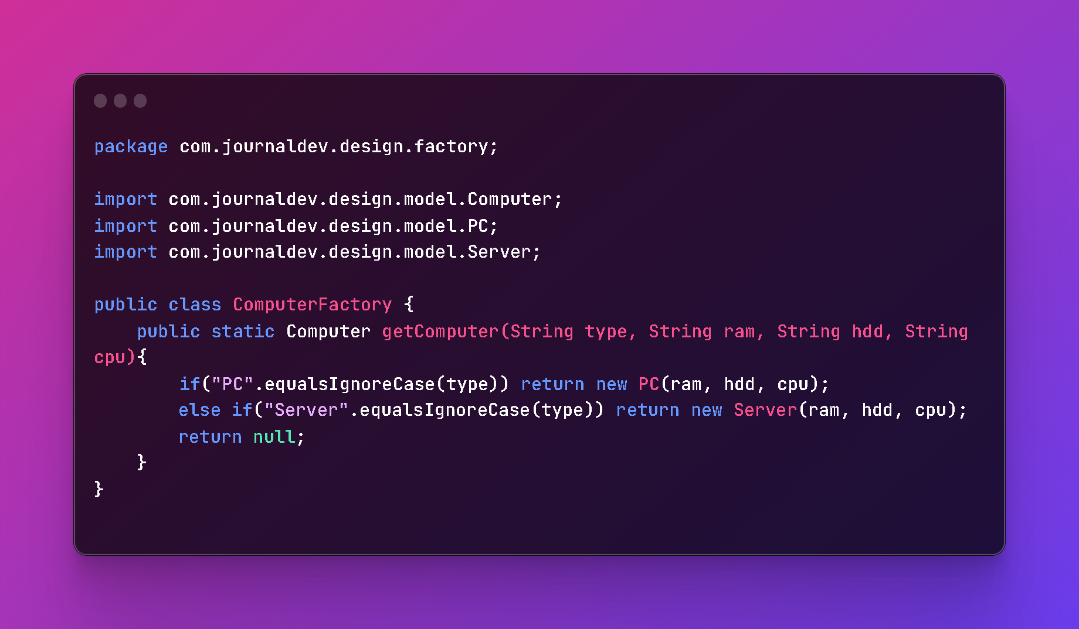
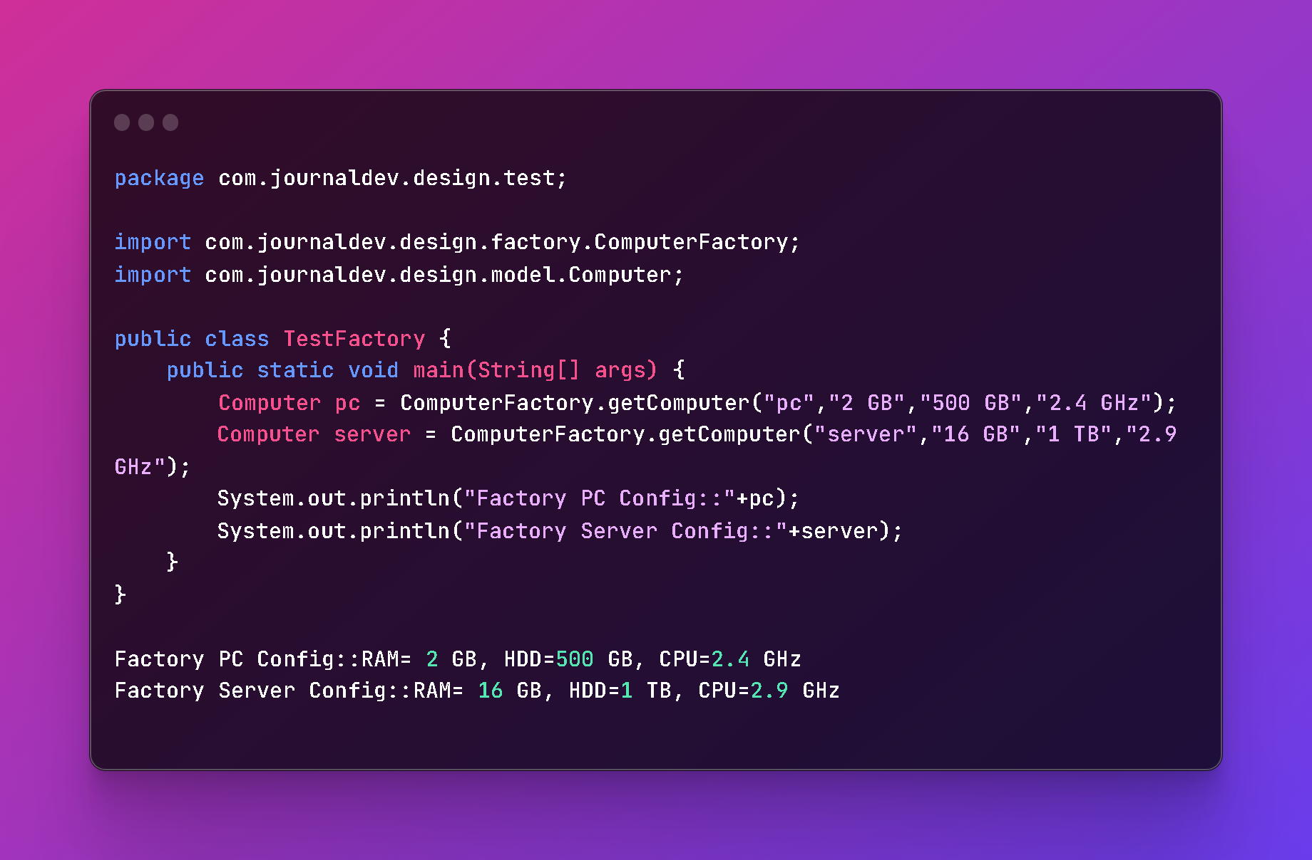
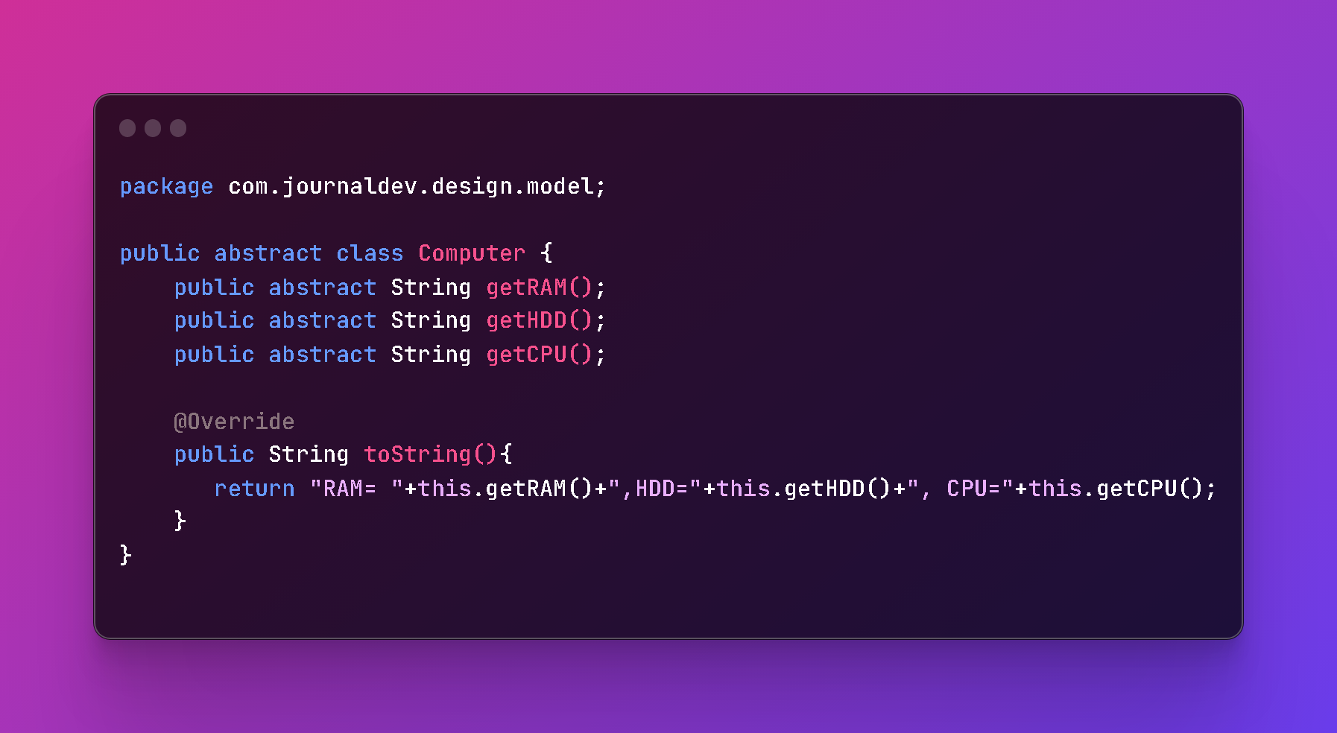

Slide 22
ABSTRACT FACTORY
The Abstract Factory design pattern is a creational pattern that provides an interface for creating families of related or dependent objects without specifying their concrete classes.
In other words, the Abstract Factory pattern allows you to create different families of related objects, each of which has a common interface, without knowing the specific classes of the objects you want to create. This pattern provides a way to encapsulate the creation of objects and decouple the client code from the specific classes of the objects being created.
The Abstract Factory pattern is useful when you need to create families of related objects that are designed to work together, and you want to ensure that the objects in each family are compatible with each other. For example, if you are designing a user interface for a software application, you might use the Abstract Factory pattern to create a family of user interface elements such as buttons, text boxes, and labels that are designed to work together and have a consistent look and feel.
Enforcing
Consistency

Slide 23
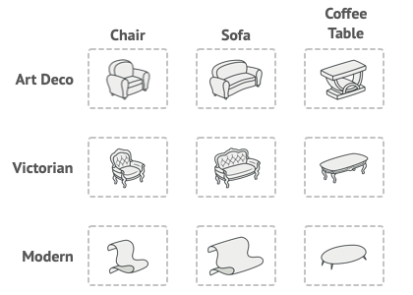

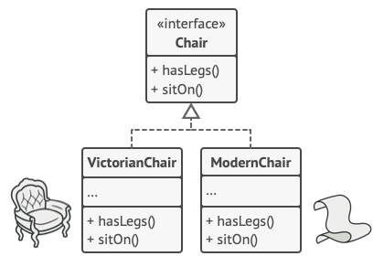
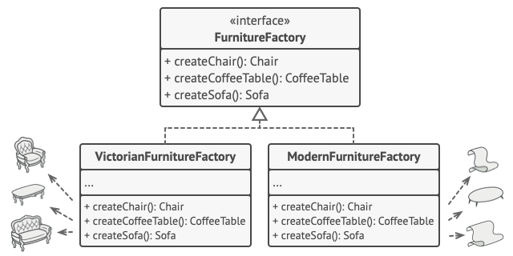

Slide 24

DIFFERENCES BETWEEN FACTORY AND ABSTRACT FACTORY
Abstraction: The Factory pattern is focused on creating a single object of a specific class, while the Abstract Factory pattern is focused on creating families of related objects without specifying their concrete classes.
Granularity: The Factory pattern is more granular than the Abstract Factory pattern. The Factory pattern is typically used to create individual objects, while the Abstract Factory pattern is used to create families of related objects.
Extensibility: The Abstract Factory pattern is more extensible than the Factory pattern. With the Abstract Factory pattern, you can add new families of related objects without modifying existing code. With the Factory pattern, you need to modify the code to add new classes.
Flexibility: The Abstract Factory pattern is more flexible than the Factory pattern. With the Abstract Factory pattern, you can create families of related objects that can be used in different contexts. With the Factory pattern, you create objects of a specific class that are used in a specific context.
Complexity: The Abstract Factory pattern is more complex than the Factory pattern. The Abstract Factory pattern involves multiple interfaces and classes, while the Factory pattern involves a single interface and class.
In summary, the main difference between the Factory and Abstract Factory patterns is that the Factory pattern is focused on creating a single object of a specific class, while the Abstract Factory pattern is focused on creating families of related objects without specifying their concrete classes. The Abstract Factory pattern is more extensible, flexible, and complex than the Factory pattern.

Slide 25
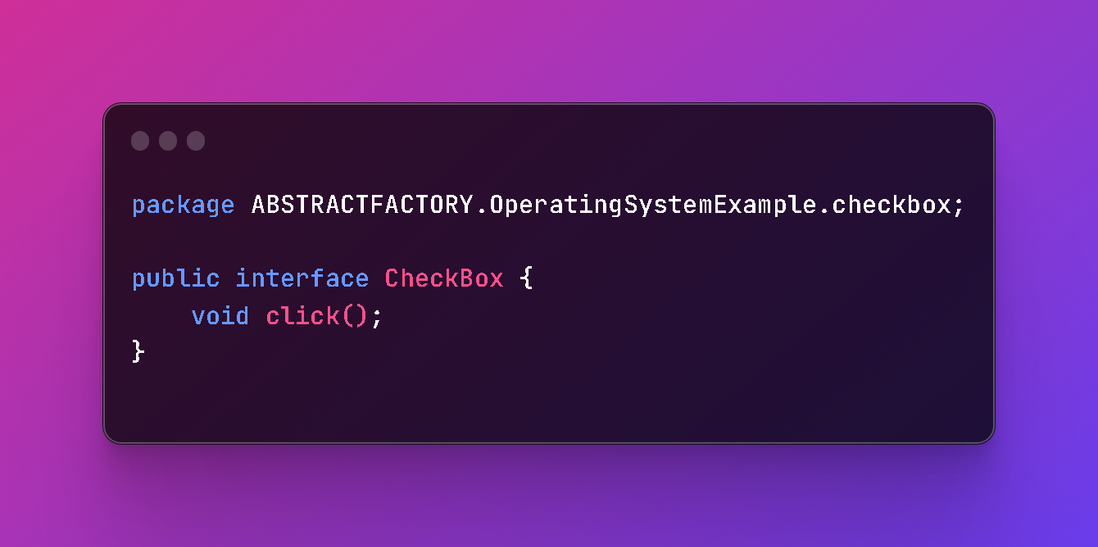
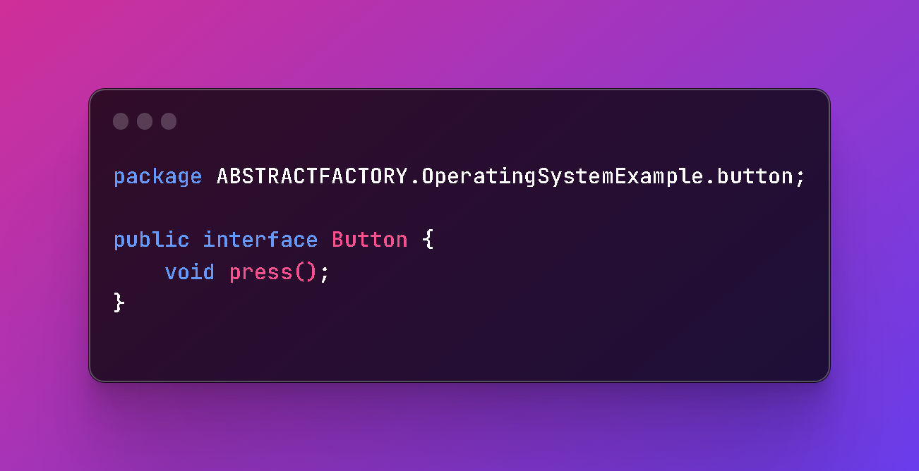
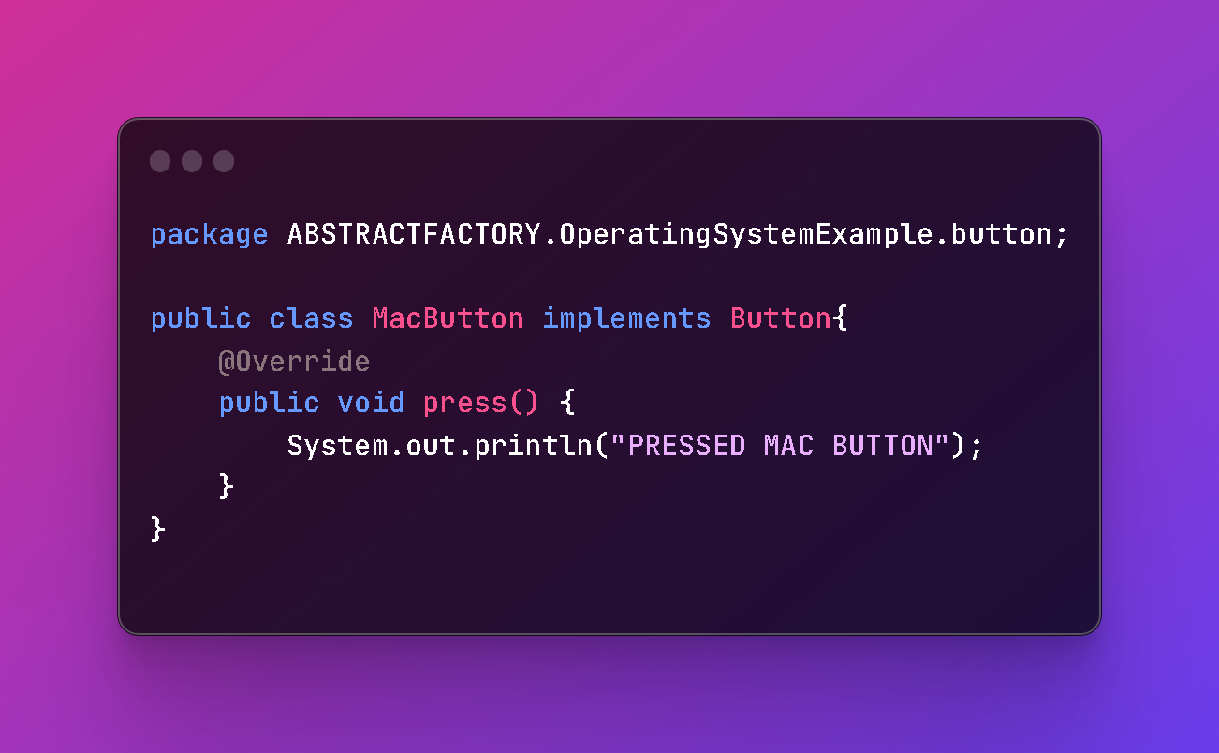
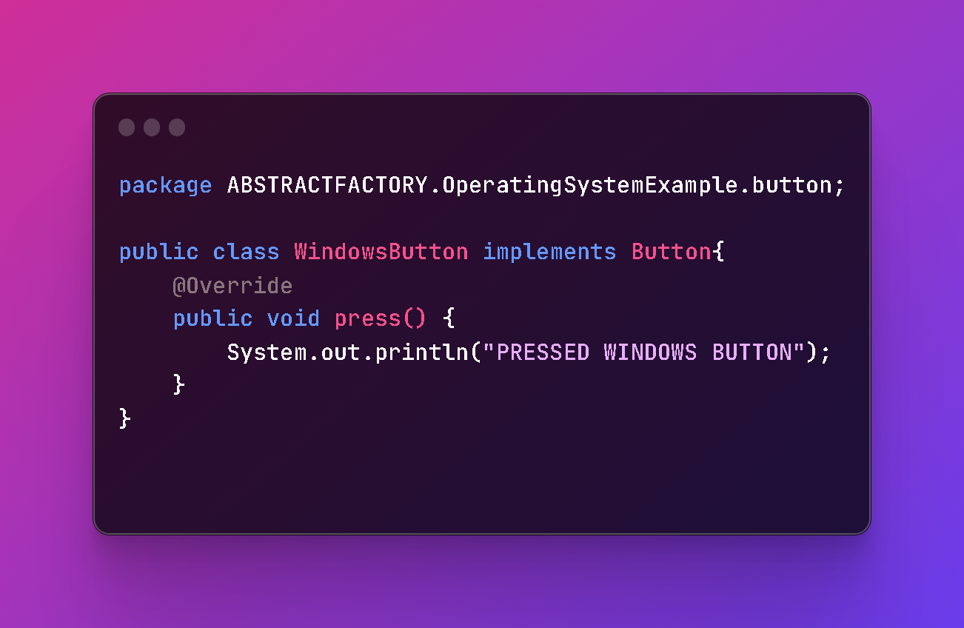
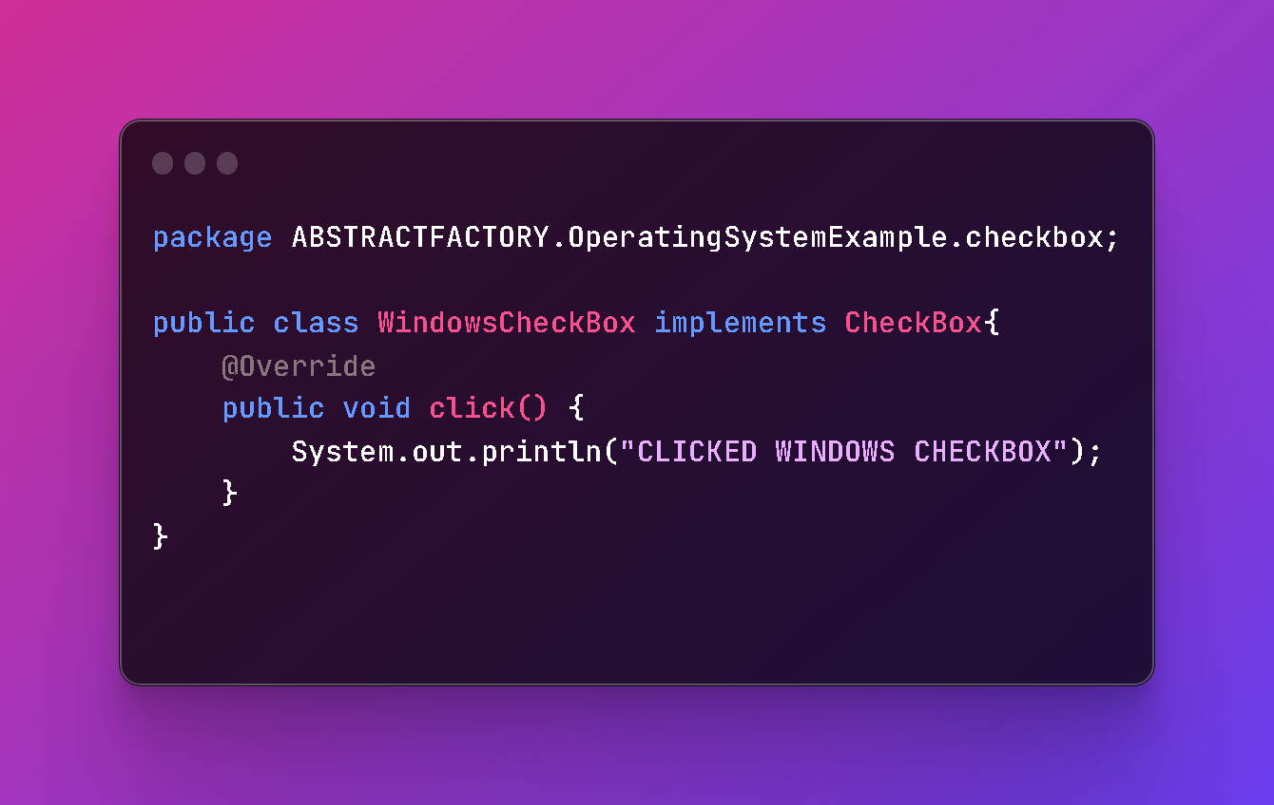
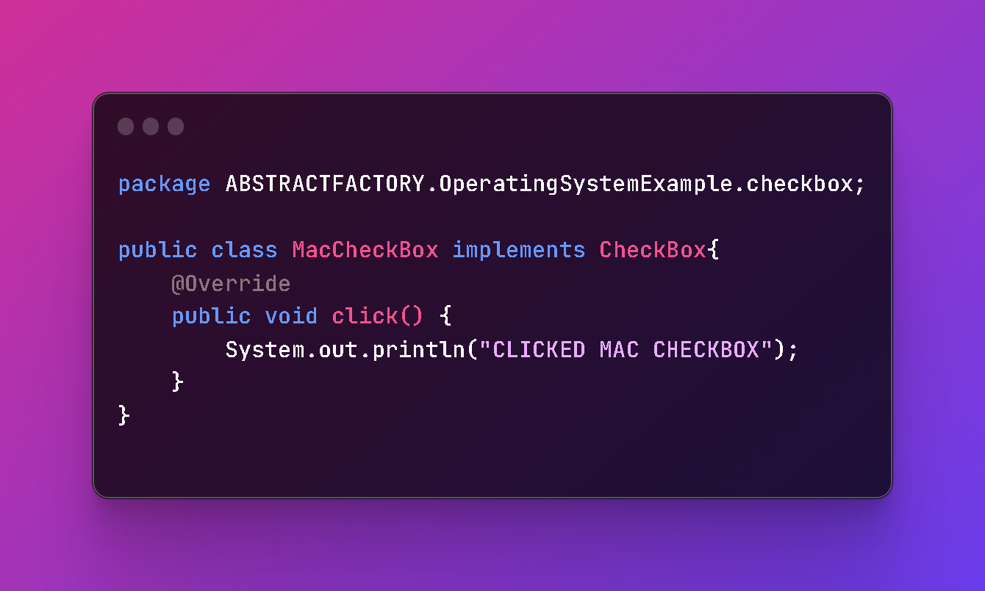

Slide 26
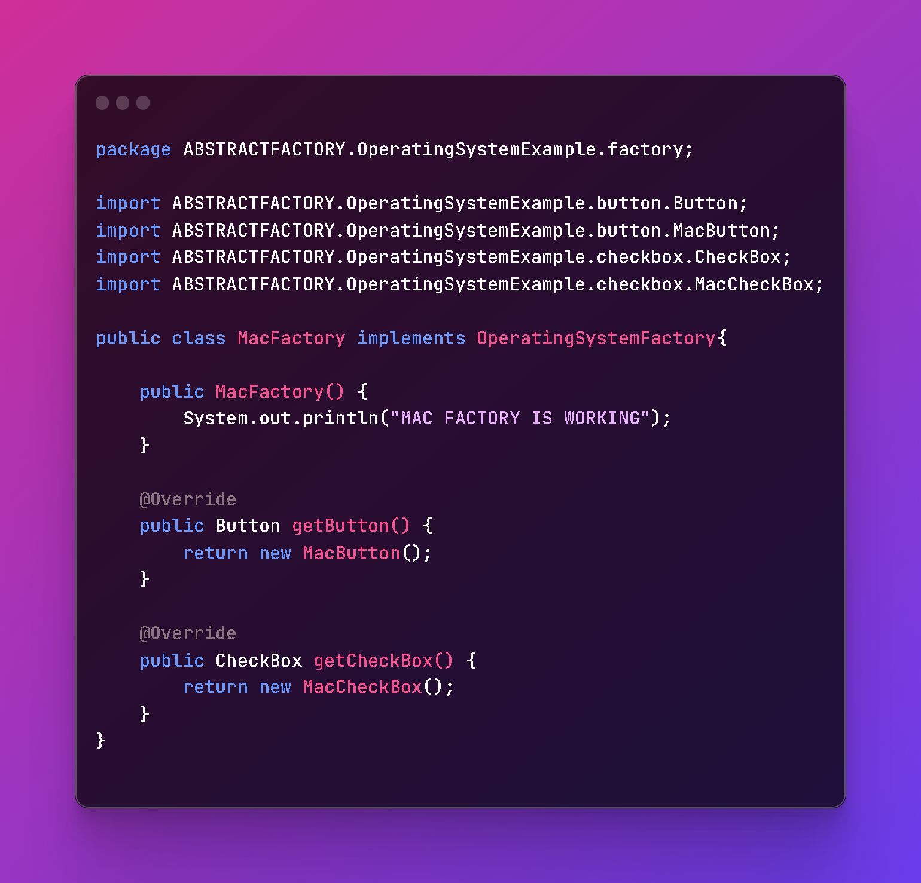
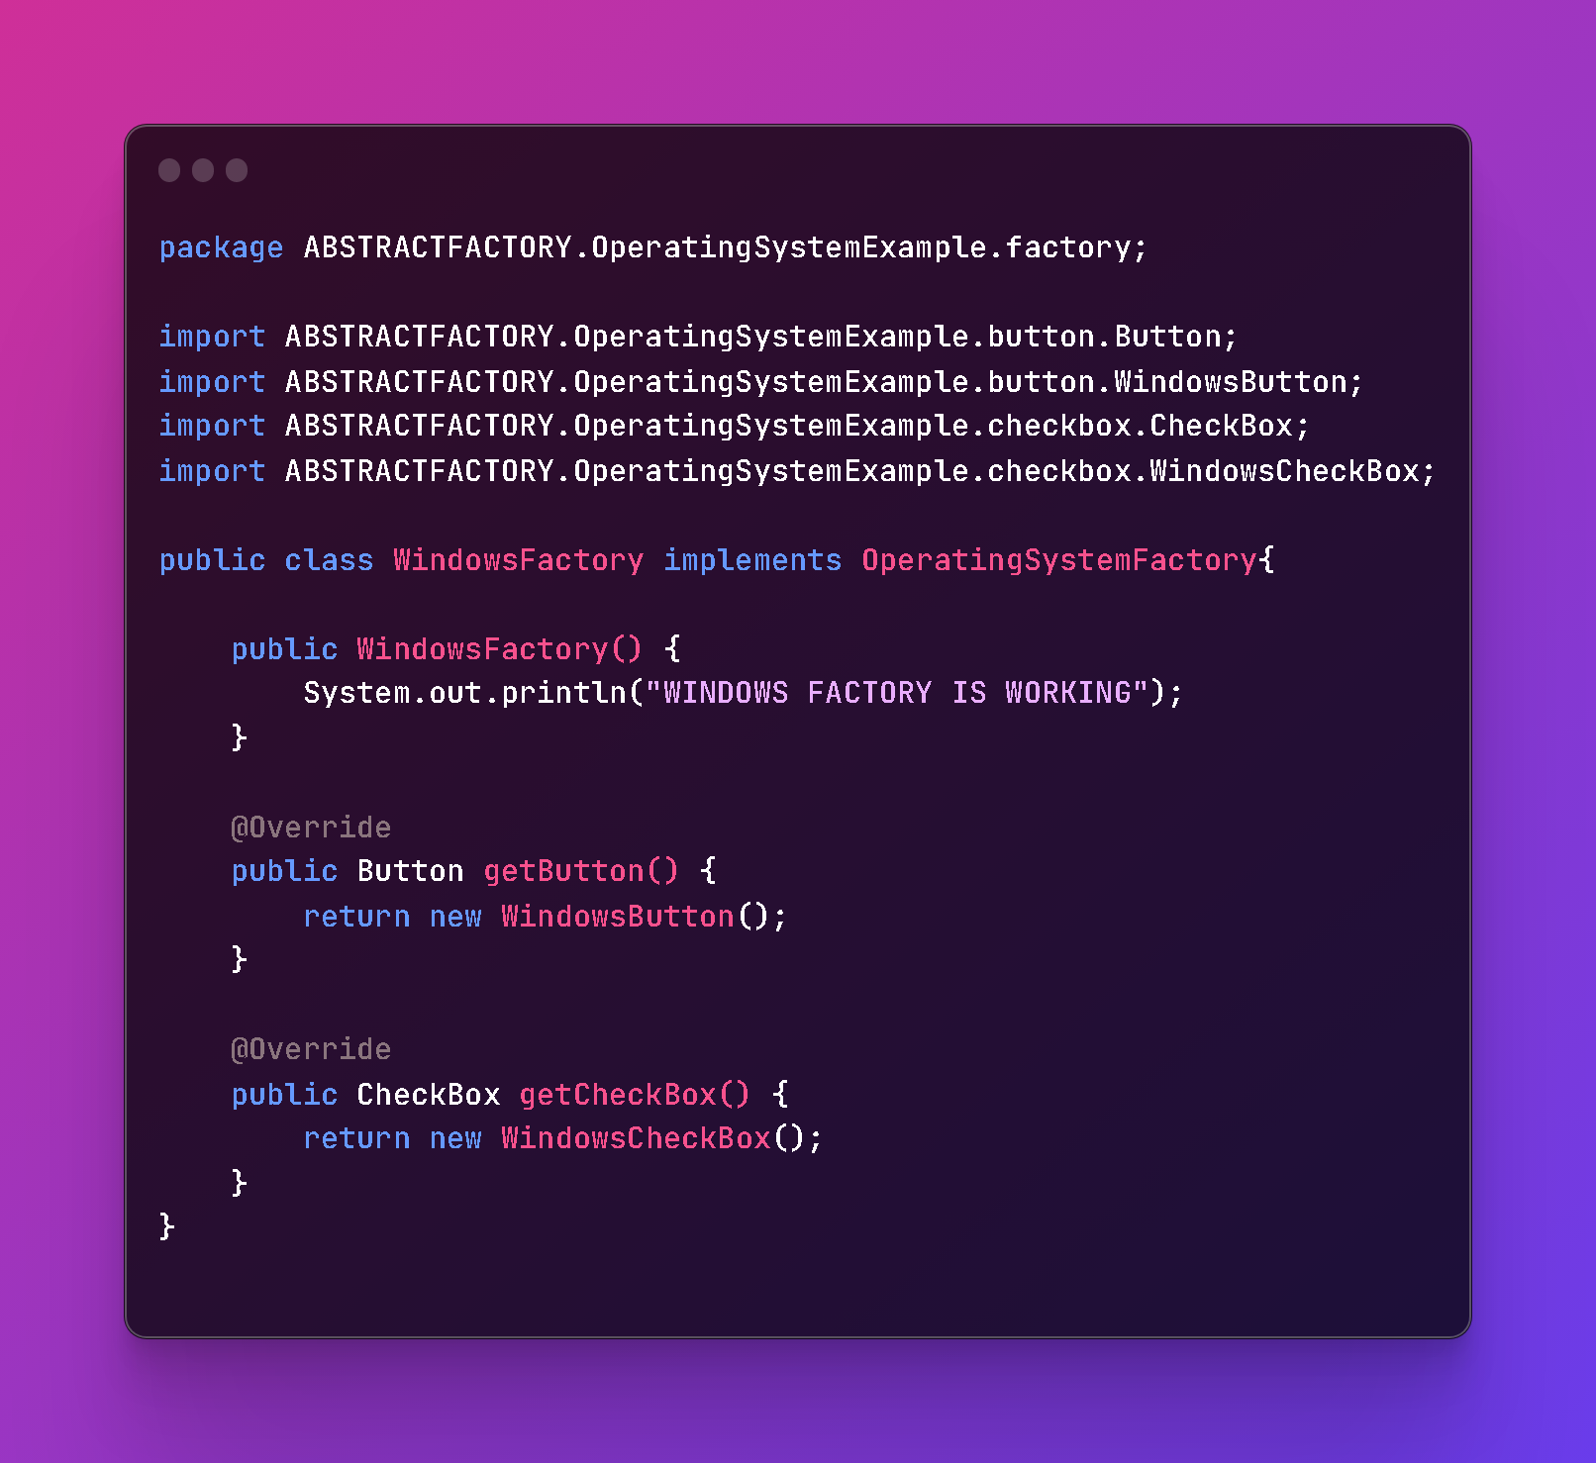
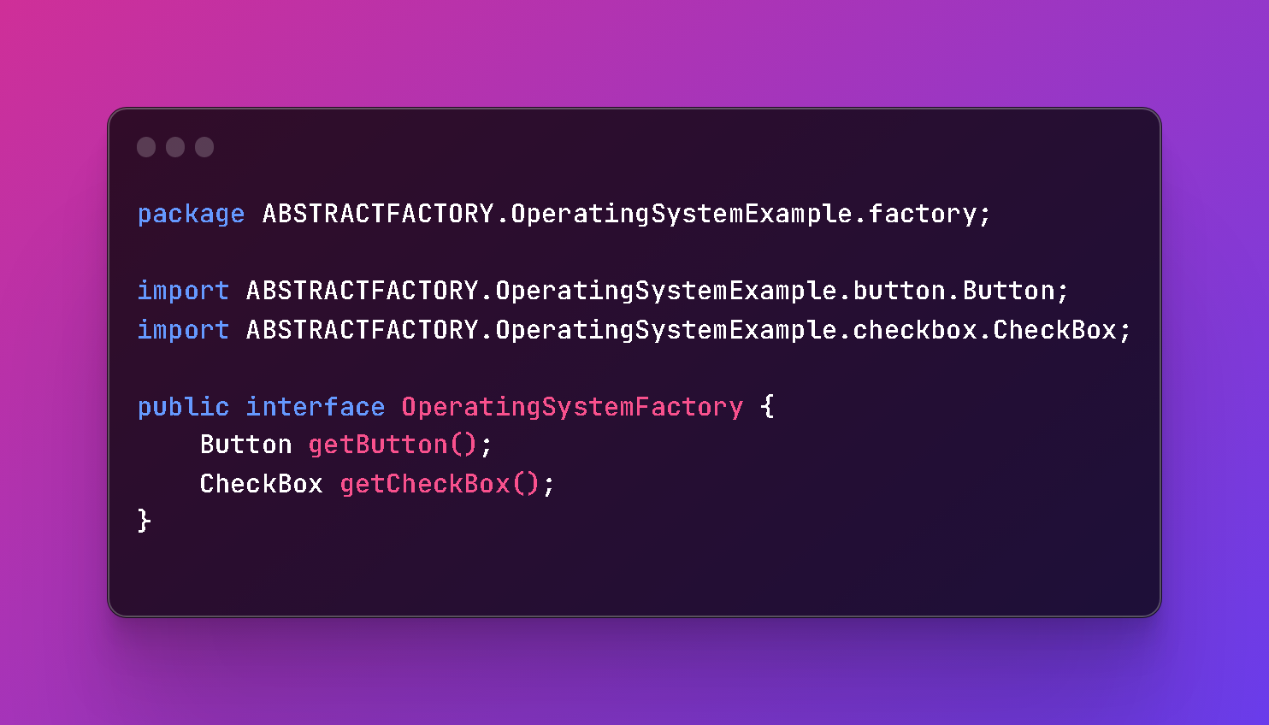

Slide 27
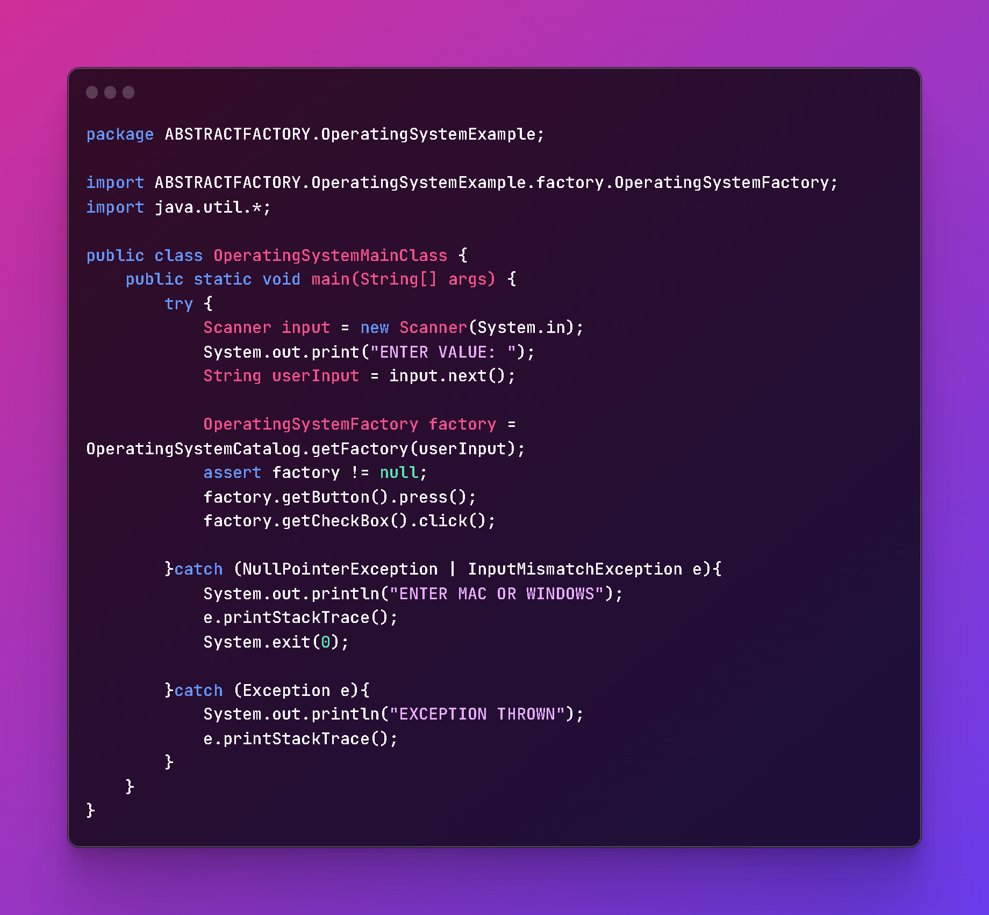
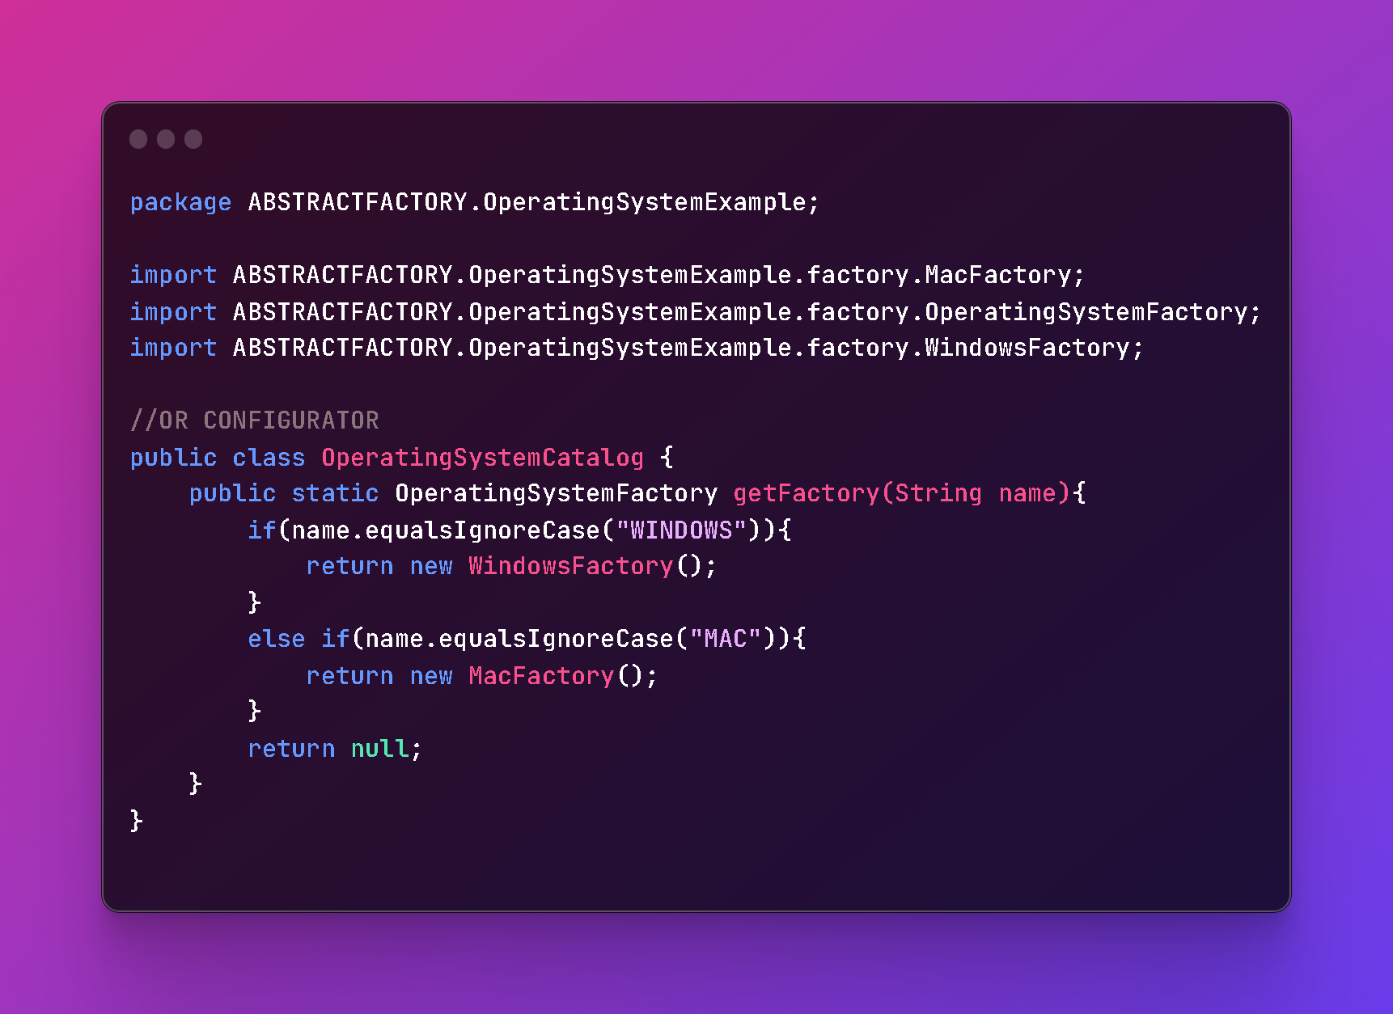

Slide 28
BUILDER
Advantages
Builder is a creational design pattern that lets you construct complex objects step by step. The pattern allows you to produce different types and representations of an object using the same construction code.
Encapsulating object creation logic
Separation of concerns
Improves code readability
Provides better control over object creation
Enables method chaining
Makes testing easier

Slide 29
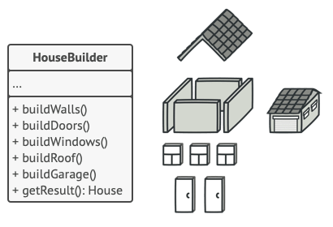
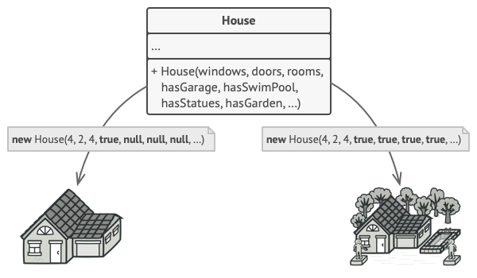
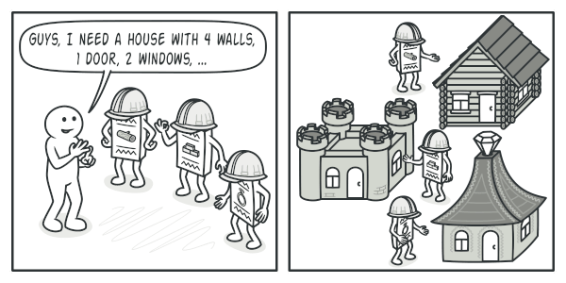
Solution
Problem
The Builder pattern suggests that you extract the object construction code out of its own class and move it to separate objects called builders.
Imagine a complex object that requires laborious, step-by-step initialization of many fields and nested objects. Such initialization code is usually buried inside a monstrous constructor with lots of parameters

Slide 30
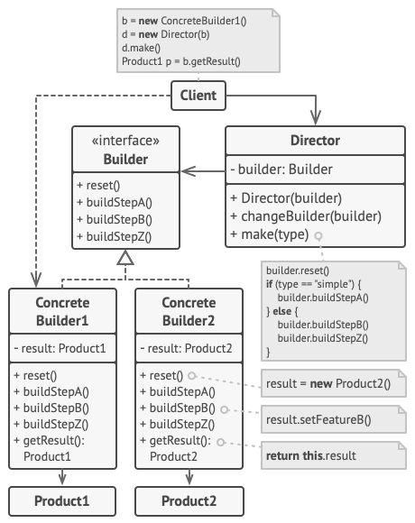
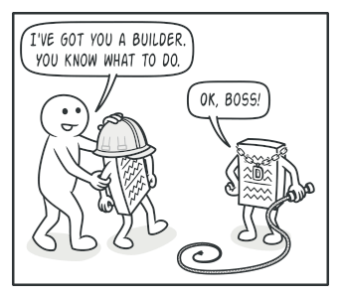
Director
You can go further and extract a series of calls to the builder steps you use to construct a product into a separate class called director. The director class defines the order in which to execute the building steps, while the builder provides the implementation for those steps.

Slide 31
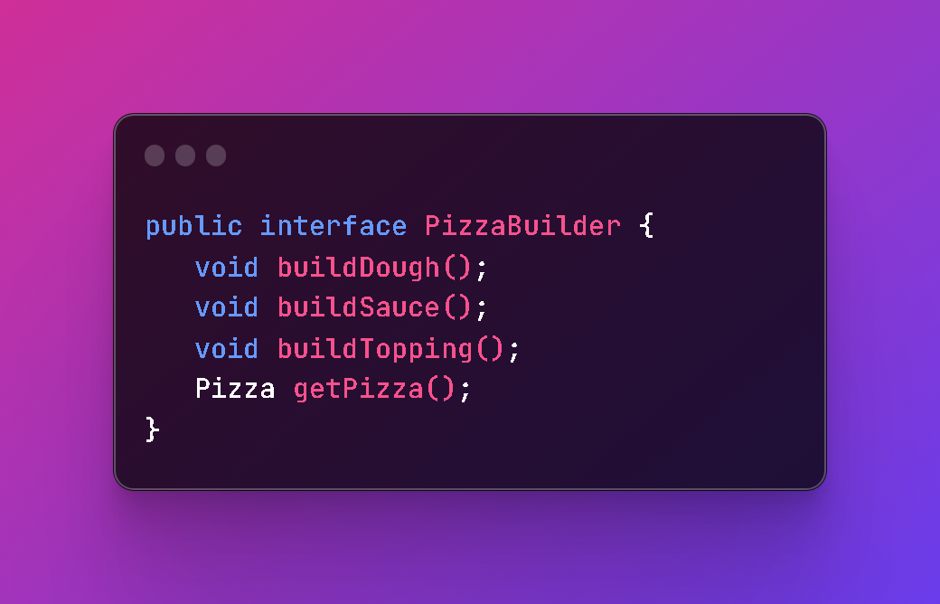
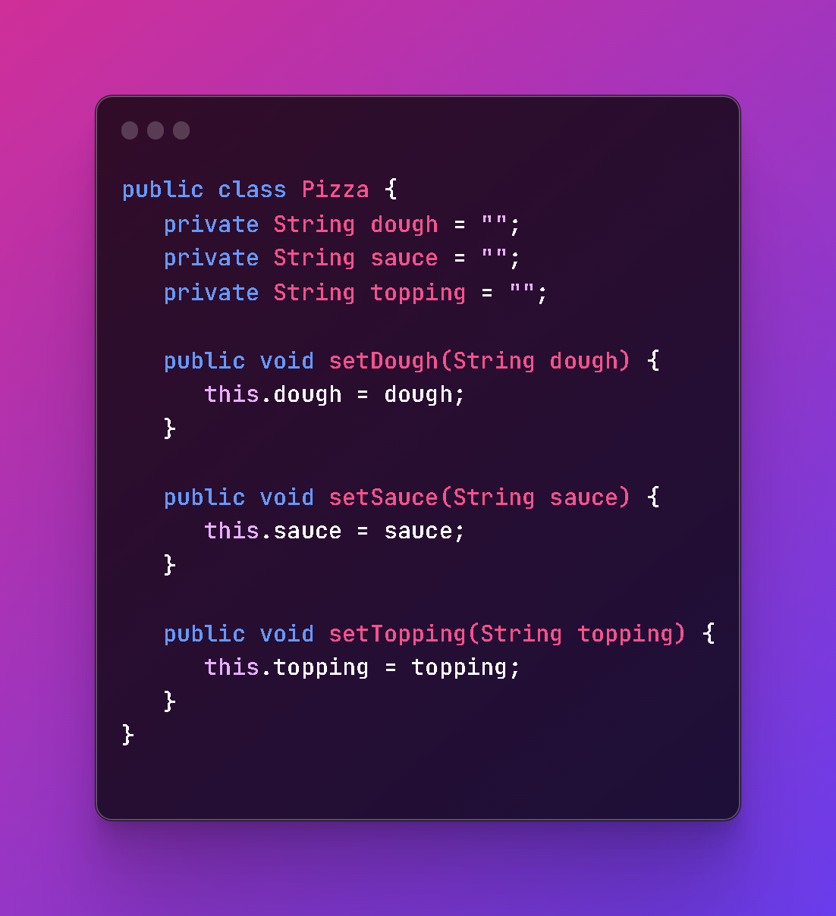
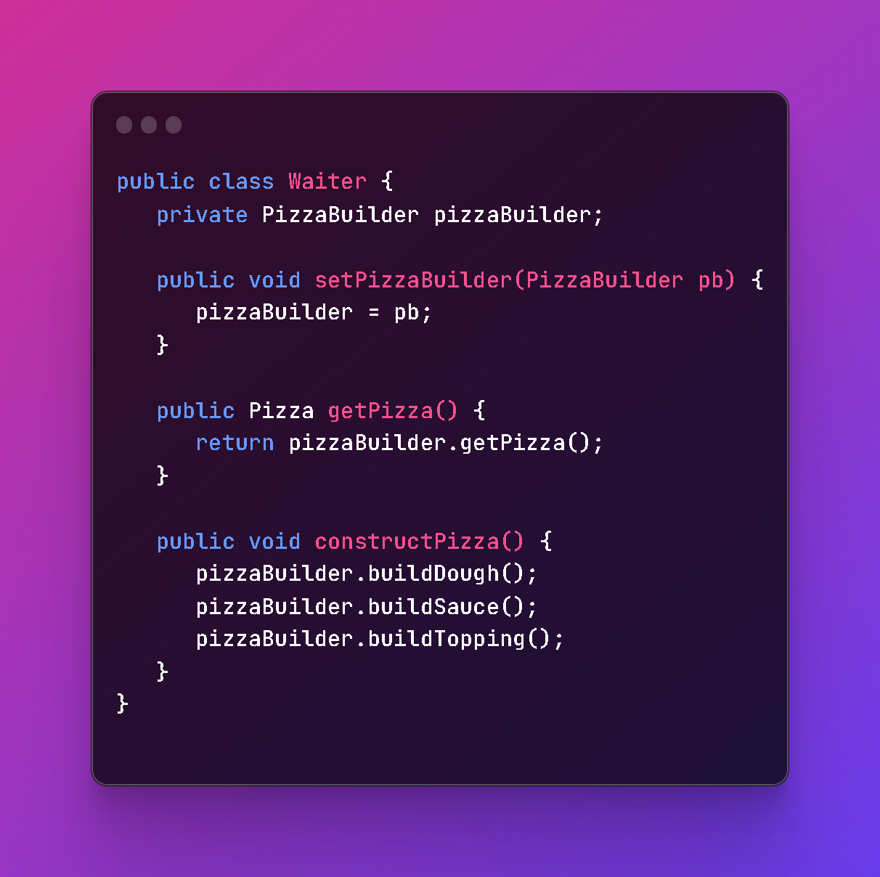

Slide 32
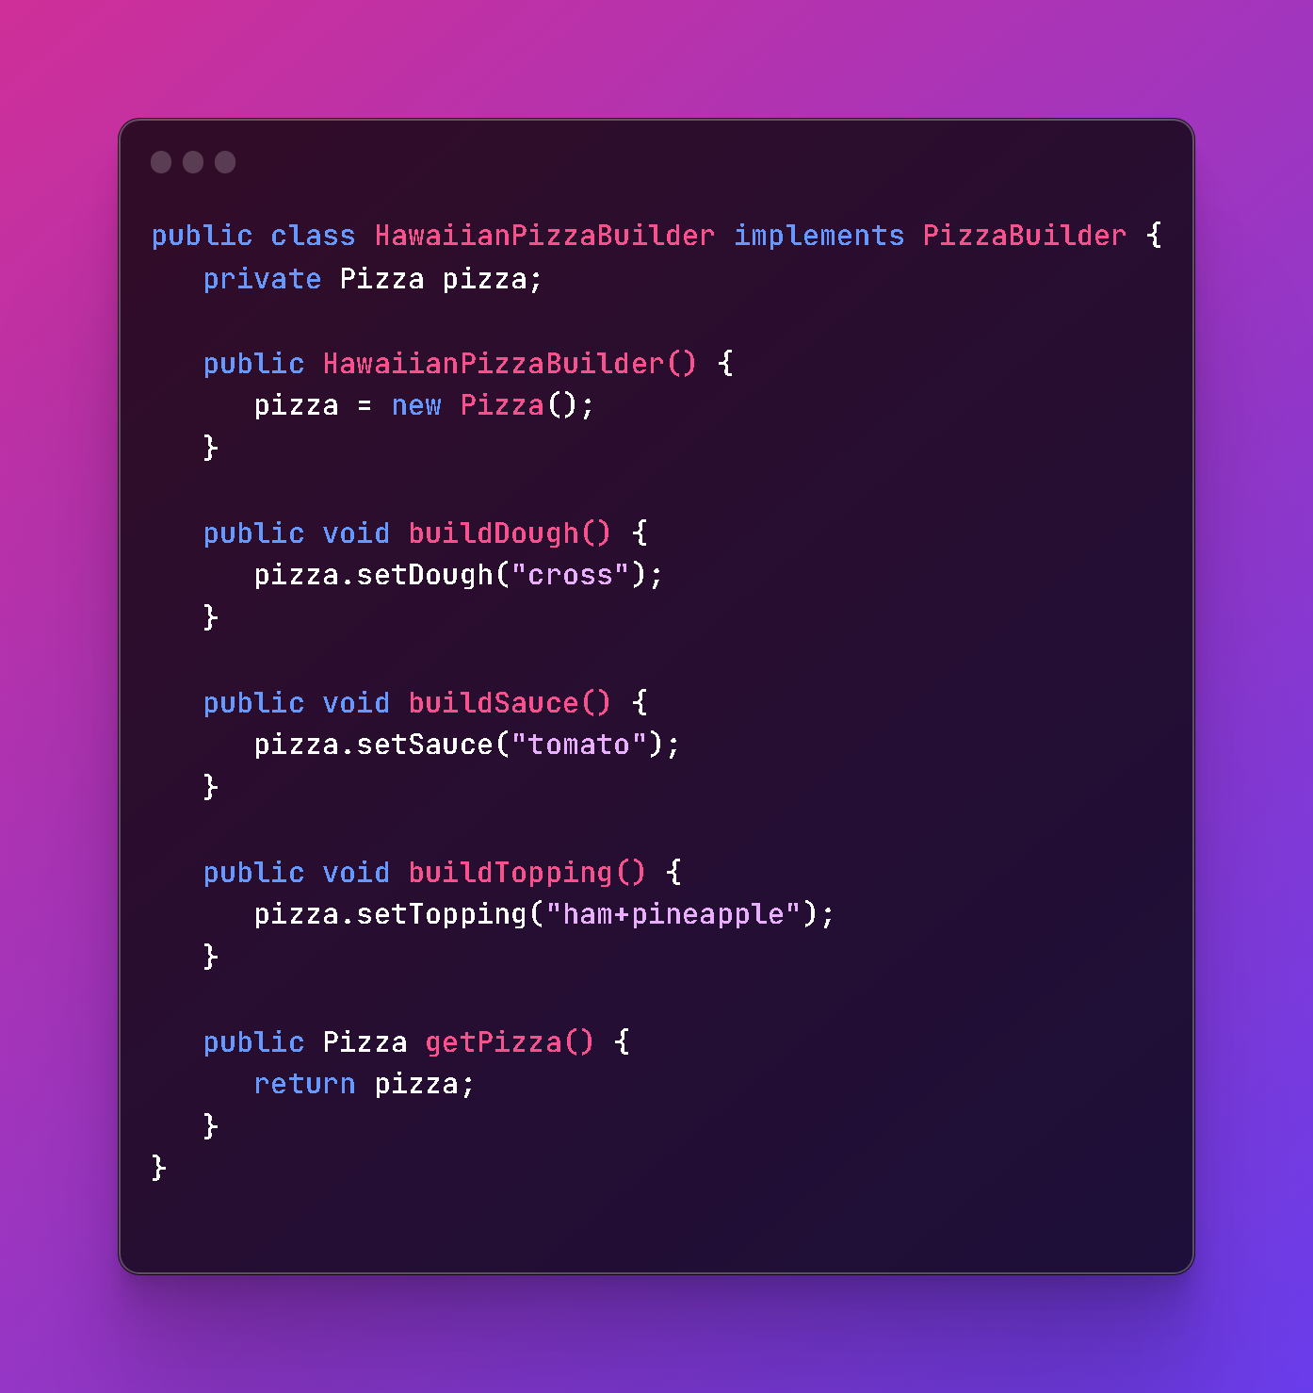

Slide 33

Thank you for listening to my presentation

